Slide 1
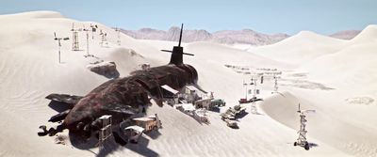
BIOGRAPHIES
* Next week we will be creating some full biographies.
* It’s being able to write about a person’s history as a way of explaining who they are now. We are going to do this for Katrina as we see her at the beginning of the film.
* We will needo be able to write character descriptions in both the present and past tenses

Slide 2
What is a pen portrait?
We are going to start off by writing a mini biography, or pen portrait of Katrina, using your plan to guide you. You can normally start with a short written description of someone - not their appearance, but things like their character, briefly where they came from, how they arrived at this point in their life and their hopes, abilities and attributes. You could add some basics interesting facts etc. We won’t go into detail like a full biography yet.
You must follow this checklist to help you get it right:
Pen Portrait Mini Biography Checklist:
A RANGE of accurate punctuation () : ; , – lots of you in year 5 not doing this – its time to start now please.
Start with how Katrina is now as a person (NOT WHAT SHE LOOKS LIKE.)
Briefly mention how she grew as a person in relation to her experiences in life – but not in detail – we’ll save this for the full biography.
MAKE SURE YOU USE COMPLEX SENTENCES WITH CONJUNCTIONS AND SUB CLAUSES – NOT JUST LISTS OF SIMPLE STATEMENTS – I have noticed we are all forgetting to do this now we re at home. It’s essential you write in an interesting way, not like a robot. (however, although, despite, unless, therefore, inspite of )

Slide 3
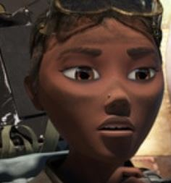
Mr Hodge’s Example:
A Pen Portrait of Katrina
I have written my short pen portrait/mini biography of Katrina, based on my plan: yours should be different so your Katrina might be a completely different character shaped by different experiences in her life – she might not be a happy, friendly character at all. Make sure you use the checklist – I have noticed lots of you not paying attention to it.
Katrina Wayland is a girl with many talents, and a dream to help the world she has seem fall into despair. Despite her tough experiences, She is bright and determined, with an imagination the size of a planet. Her years of struggle in a tough world, have given her a fierce bravery and a never-give-up attitude. From the early years of her life on a struggling farm in the eastern wastelands, her parents recognised her desire to learn, and to fly. She paid attention in school, blinding her classmates with her scientific knowledge and tales of taking the controls alone on her fathers crop-sprayer. As she grew older, failing crops forced her family into the city: an experience which taught her how to think for herself and be resilient – having to work hard in factories, learn new skills quickly and put bread on the table for sick parents.
However, a chance meeting with a genius inventor, gave her the opportunity to realise her dream, and together they combined their scientific skills and imagination to create the rain-maker machine. Katrina was always one to make clear decisions, and, having attracted the unwanted attention from criminals in the city who wanted the machine, made a heart-breaking decision : to leave her parents and make her way alone, back to her abandoned home, with a dream to get back in the air and make it rain – whatever the cost.

