Slide 1
Year 1/2 – Spring Block 4 – Weight and Volume – Step 1
About This Resource:
This PowerPoint has been designed to support your teaching of this small step from the Mixed Age planning. It includes a starter activity suitable for each year group and an example of each question from the Varied Fluency and Reasoning and Problem Solving resources also provided in this pack (separate for each year group). Each slide has the year group identified in the bottom right-hand corner. We recommend that you look through this PowerPoint in advance and decide whether to work through all examples provided or a selection of them depending on the needs of your class.
National Curriculum Objectives:
Mathematics Year 1: (1M2) Measure and begin to record: mass/weight
Mathematics Year 1: (1M1) Compare, describe and solve practical problems for: mass/weight [for example, heavy/light, heavier than, lighter than]
Mathematics Year 2: (2M1) Compare and order lengths, mass, volume/capacity and record the results using >, < and =
More Year 1 and Year 2 Weight and Volume resources.
Did you like this resource? Don’t forget to review it on our website.
© Classroom Secrets Limited 2019

Slide 2
Year 1/2 – Spring Block 4 – Weight and Volume
Step 1
Year 1: Introduce Weight and Mass
Year 2: Compare Mass
© Classroom Secrets Limited 2019

Slide 3
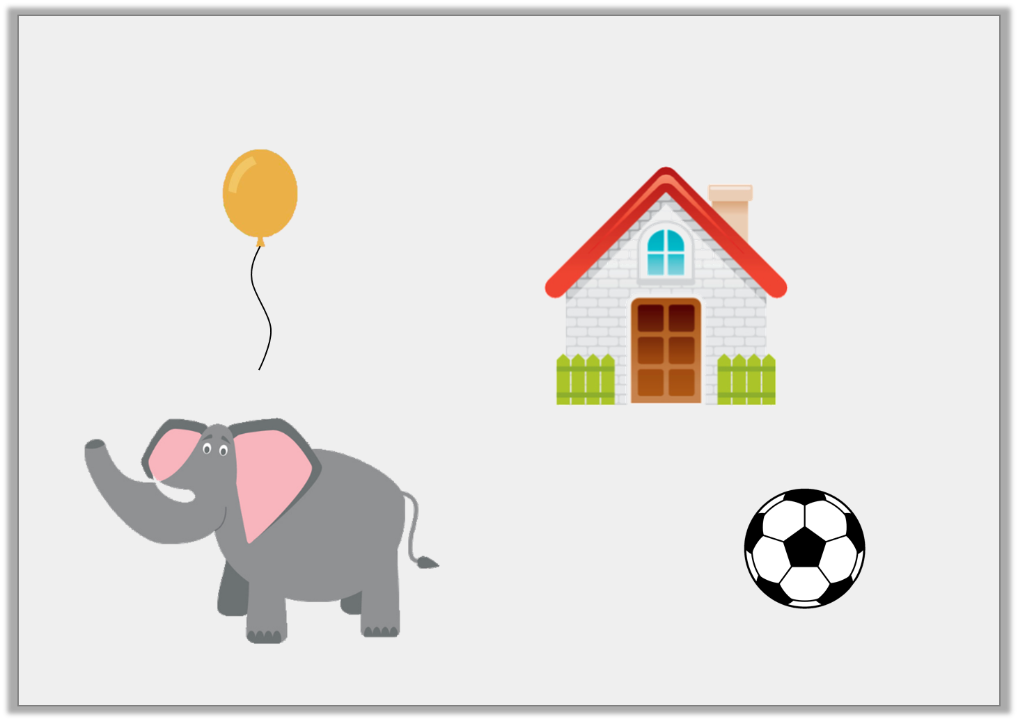
Introduction
Which items do you think are too heavy for you to pick up?
Y1
© Classroom Secrets Limited 2019

Slide 4
Introduction
Which items do you think are too heavy for you to pick up?
Y1
© Classroom Secrets Limited 2019

Slide 5
Introduction
Complete the sentences.
Word bank: more less same
The pumpkin weighs the as the melon.
The lemon weighs than the apple.
The sweetcorn weighs than the tomato.
Y2

Slide 6
Introduction
Complete the sentences.
Word bank: more less same
The pumpkin weighs the as the melon.
same
less
The lemon weighs than the apple.
more
The sweetcorn weighs than the tomato.
Y2

Slide 7
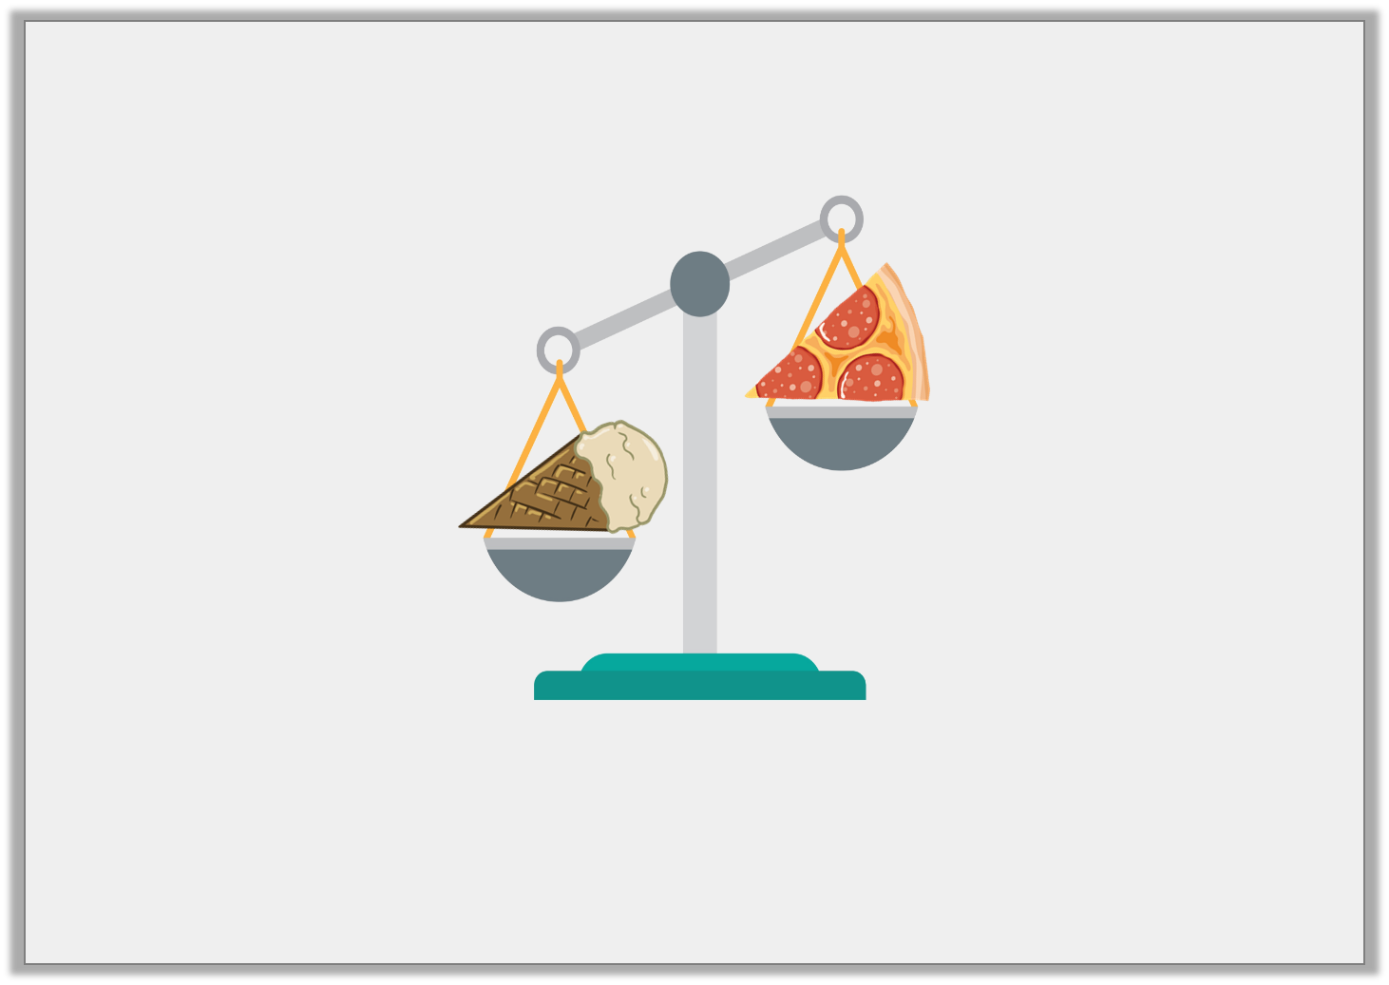
Varied Fluency 1
True or false? The pizza is heavier than the ice cream.
Y1
© Classroom Secrets Limited 2019

Slide 8
Varied Fluency 1
True or false? The pizza is heavier than the ice cream.
False.
The pizza is lighter than the ice cream.
Y1
© Classroom Secrets Limited 2019

Slide 9
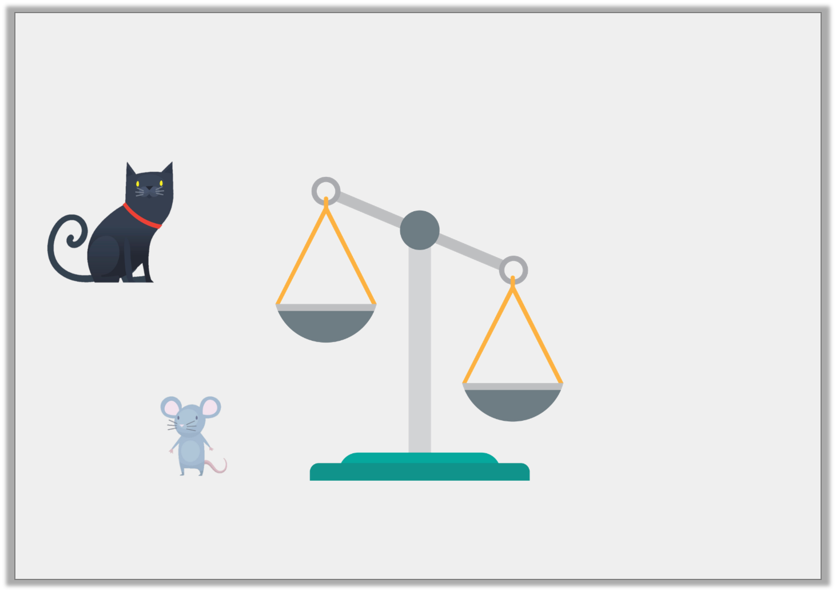
Varied Fluency 2
The cat is heavier than the mouse.
Draw them in the correct place on the scales.
Y1
© Classroom Secrets Limited 2019

Slide 10
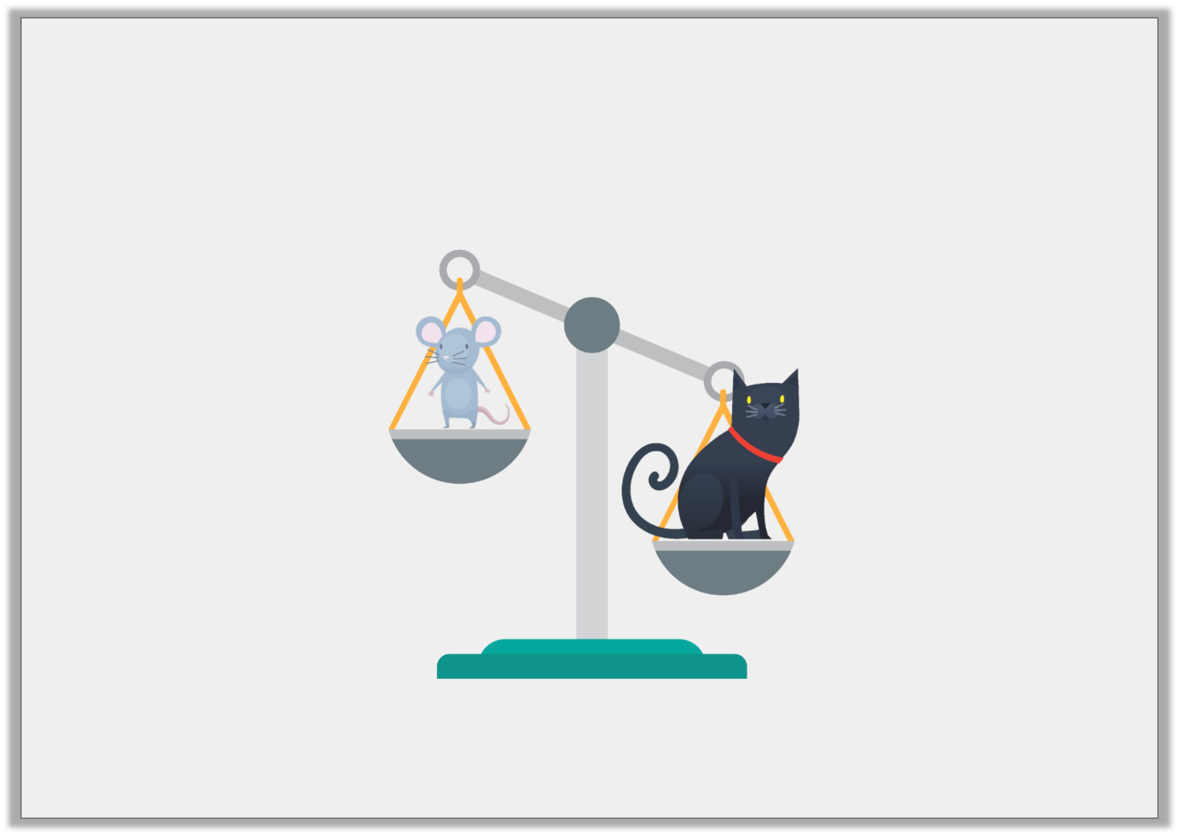
Varied Fluency 2
The cat is heavier than the mouse.
Draw them in the correct place on the scales.
Y1
© Classroom Secrets Limited 2019

Slide 11
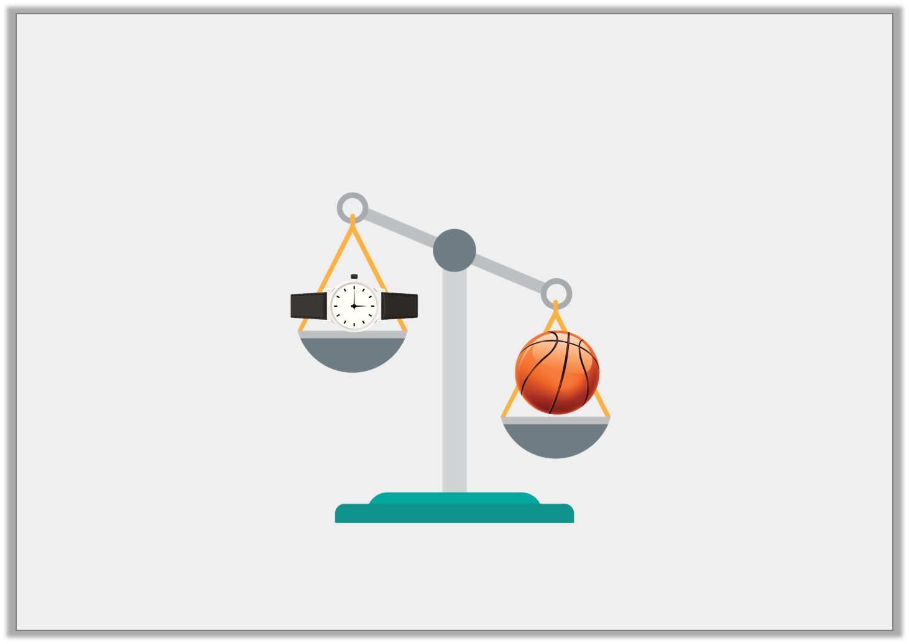
Varied Fluency 3
Is the watch heavier or lighter than the basketball?
Y1
© Classroom Secrets Limited 2019

Slide 12
Varied Fluency 3
Is the watch heavier or lighter than the basketball?
Lighter
Y1
© Classroom Secrets Limited 2019

Slide 13
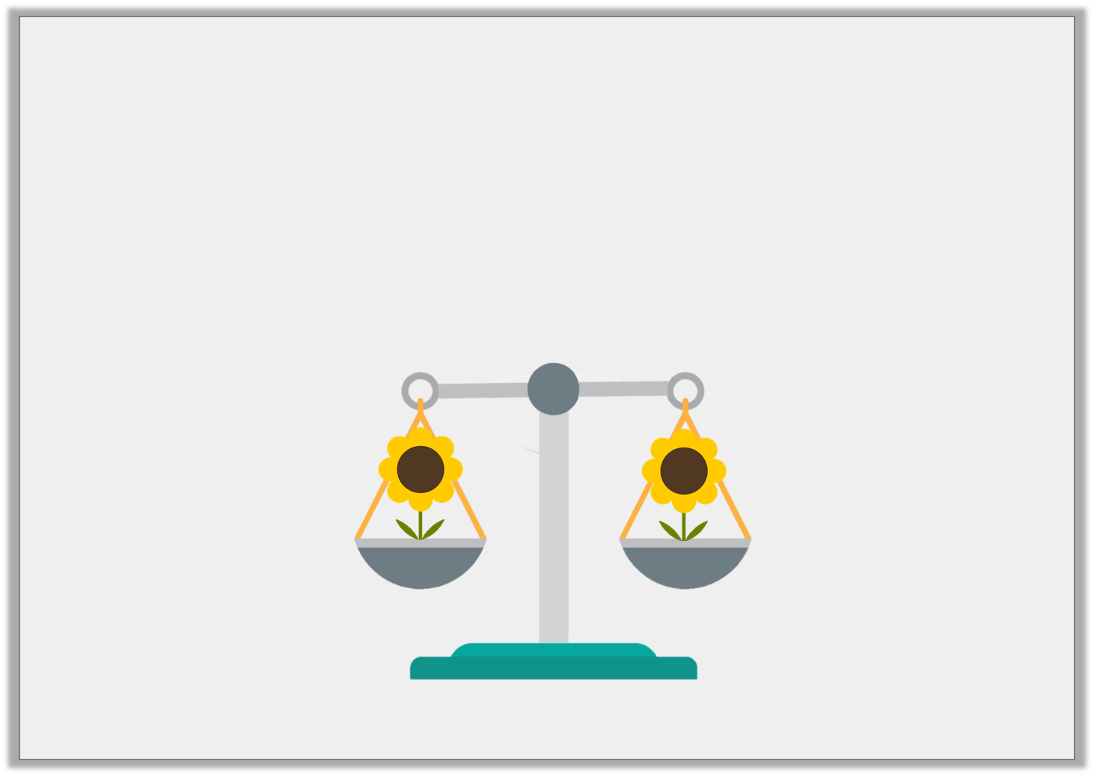
Varied Fluency 4
The balance scale is level.
Circle the word that describes the weight of the flowers.
Heavier |  | Equal |  | Lighter
Y1
© Classroom Secrets Limited 2019

Slide 14
Varied Fluency 4
The balance scale is level.
Circle the word that describes the weight of the flowers.
Heavier |  | Equal |  | Lighter
Y1
© Classroom Secrets Limited 2019

Slide 15
Varied Fluency 1
Draw lines to show which side of the
balance the objects belong.
Y2

Slide 16
Varied Fluency 1
Draw lines to show which side of the
balance the objects belong.
Y2

Slide 17
Varied Fluency 2
Use the words ‘more’ or ‘less’ to complete the sentence.
A feather weighs __________
than a pebble.
Y2
© Classroom Secrets Limited 2018

Slide 18
Varied Fluency 2
Use the words ‘more’ or ‘less’ to complete the sentence.
A feather weighs __________
than a pebble.
less
Y2
© Classroom Secrets Limited 2018

Slide 19
Varied Fluency 3
Order these objects from heaviest to lightest.
Y2

Slide 20
Varied Fluency 3
Order these objects from heaviest to lightest.
Y2

Slide 21
Varied Fluency 4
Which symbol could you swap for the underlined words?
A football is lighter than a bowling ball.
An elephant is heavier than a bat.
<
>
Y2
© Classroom Secrets Limited 2018

Slide 22
Varied Fluency 4
Which symbol could you swap for the underlined words?
A football is lighter than a bowling ball.
An elephant is heavier than a bat.
<
>
<
>
Y2
© Classroom Secrets Limited 2018

Slide 23
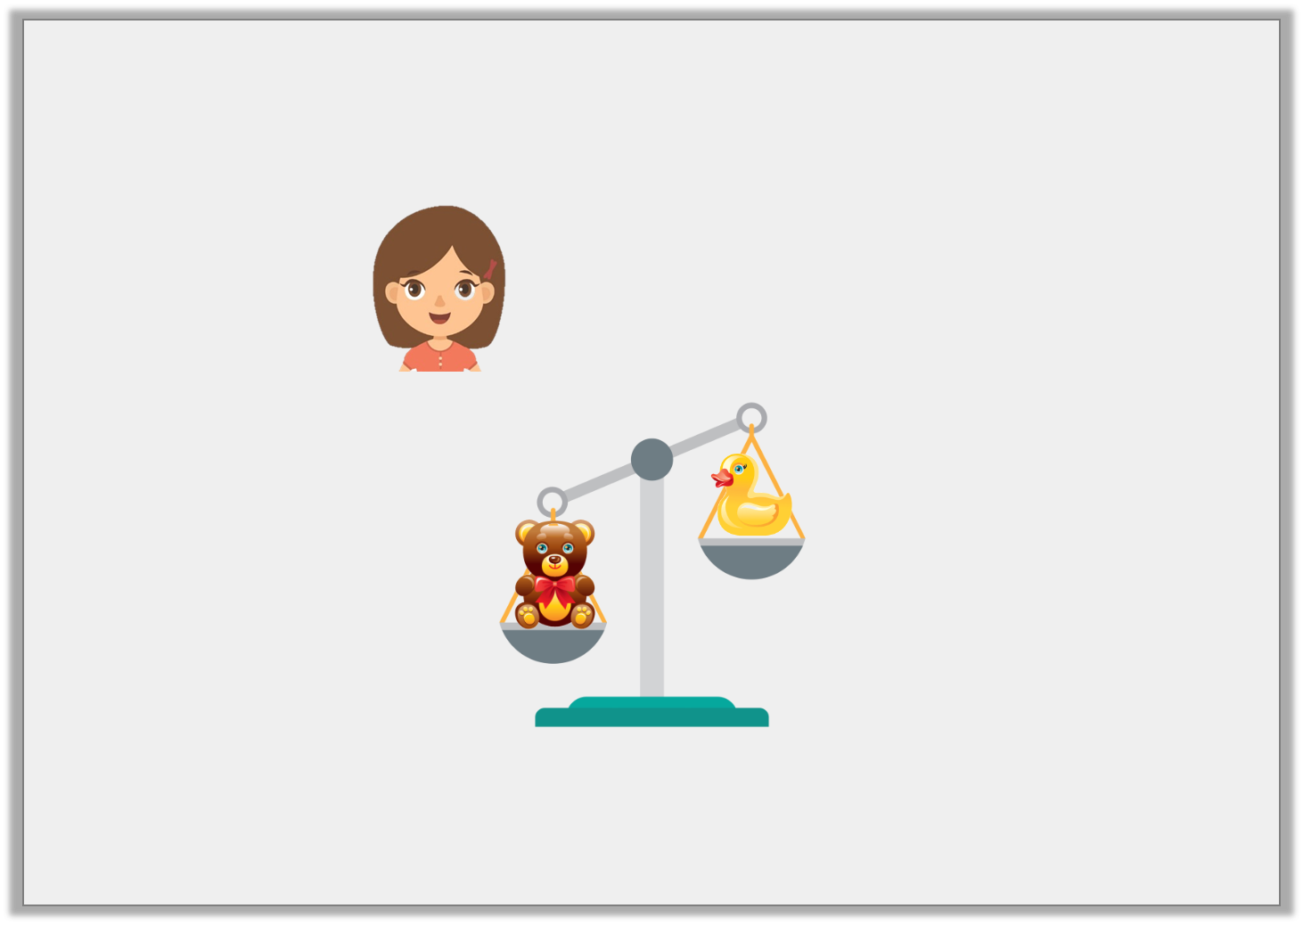
Reasoning 1
Is Aubrey correct?
Explain why.
The duck is heavier than the teddy.
Y1
© Classroom Secrets Limited 2019

Slide 24
Reasoning 1
Is Aubrey correct?
Explain why.
Aubrey is incorrect because…
The duck is heavier than the teddy.
Y1
© Classroom Secrets Limited 2019

Slide 25
Reasoning 1
Is Aubrey correct?
Explain why.
Aubrey is incorrect because the balance scale with the teddy is down. This means that the teddy is the heaviest, not the duck.
The duck is heavier than the teddy.
Y1
© Classroom Secrets Limited 2019

Slide 26
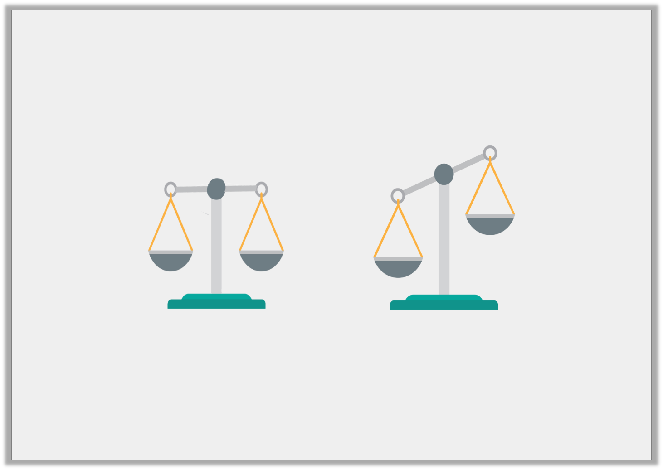
Problem Solving 1
Two identical oranges were put on each side of the balance scales.
Would the balance scales look like A or B?
A |  | B
Y1
© Classroom Secrets Limited 2019

Slide 27
Problem Solving 1
Two identical oranges were put on each side of the balance scales.
Would the balance scales look like A or B?
A |  | B
Y1
© Classroom Secrets Limited 2019

Slide 28
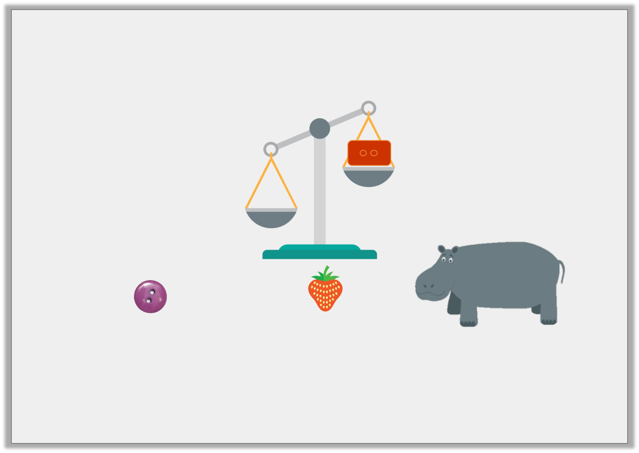
Reasoning 2
Isla wants an object that will be heavier than the brick.
Which item should she choose and why?
A | B | C
Y1
© Classroom Secrets Limited 2019

Slide 29
Reasoning 2
Isla wants an object that will be heavier than the brick.
Which item should she choose and why?
Isla should choose C because…
A | B | C
Y1
© Classroom Secrets Limited 2019

Slide 30
Reasoning 2
Isla wants an object that will be heavier than the brick.
Which item should she choose and why?
Isla should choose C because a hippo would be the heaviest out of all of the items.
A | B | C
Y1
© Classroom Secrets Limited 2019

Slide 31
Reasoning 1
True or false?
Explain your answer.
Y2

Slide 32
Reasoning 1
True or false?
Explain your answer.
True, because...
Y2

Slide 33
Reasoning 1
True or false?
Explain your answer.
True, because the scale shows the backpack is heavier than the camera. A backpack full of equipment would be heavier than one camera.
Y2

Slide 34
Problem Solving 1
Look at the scales below.
Use one item from each scale above to make the scale below correct. Which item goes in place of each letter?
Y2

Slide 35
Problem Solving 1
Look at the scales below.
Use one item from each scale above to make the scale below correct. Which item goes in place of each letter?
Y2

Slide 36
Reasoning 2
Ishmael looks at the items on the scales. He writes,
Is he correct? Explain your answer.
Y2

Slide 37
Reasoning 2
Ishmael looks at the items on the scales. He writes,
Is he correct? Explain your answer.
Ishmael is wrong because...
Y2

Slide 38
Reasoning 2
Ishmael looks at the items on the scales. He writes,
Is he correct? Explain your answer.
Ishmael has used the wrong symbol, he has written the shovel is less than the torch. The shovel is actually heavier than the torch so he should have written, a shovel > a torch.
Y2

