Slide 1
Year 1/2 – Spring Block 4 – Weight and Volume – Step 3
About This Resource:
This PowerPoint has been designed to support your teaching of this small step from the Mixed Age planning. It includes a starter activity suitable for each year group and an example of each question from the Varied Fluency and Reasoning and Problem Solving resources also provided in this pack (separate for each year group). Each slide has the year group identified in the bottom right-hand corner. We recommend that you look through this PowerPoint in advance and decide whether to work through all examples provided or a selection of them depending on the needs of your class.
National Curriculum Objectives:
Mathematics Year 1: (1M1) Compare, describe and solve practical problems for:
lengths and heights [for example, long/short, longer/shorter, tall/short, double/half]mass/weight [for example, heavy/light, heavier than, lighter than]
capacity and volume [for example, full/empty, more than, less than, half, half full, quarter]
Time [for example, quicker, slower, earlier, later]
Mathematics Year 1: (1M2) Measure and begin to record: lengths and heights mass/weight capacity and volume
time (hours, minutes, seconds)
Mathematics Year 2: (2M1) Compare and order lengths, mass, volume/capacity and record the results using >, < and =
Mathematics Year 2: (2M2) Choose and use appropriate standard units to estimate and measure length/height in any direction (m/cm); mass (kg/g); temperature (°C); capacity (litres/ml) to the nearest appropriate unit, using rulers, scales, thermometers and measuring vessels
More Year 1 and Year 2 Weight and Volume resources.
Did you like this resource? Don’t forget to review it on our website.
© Classroom Secrets Limited 2019

Slide 2
Year 1/2 – Spring Block 4 – Weight and Volume
Step 3
Year 1: Compare Mass
Year 2: Measure Mass (kg)
© Classroom Secrets Limited 2019

Slide 3
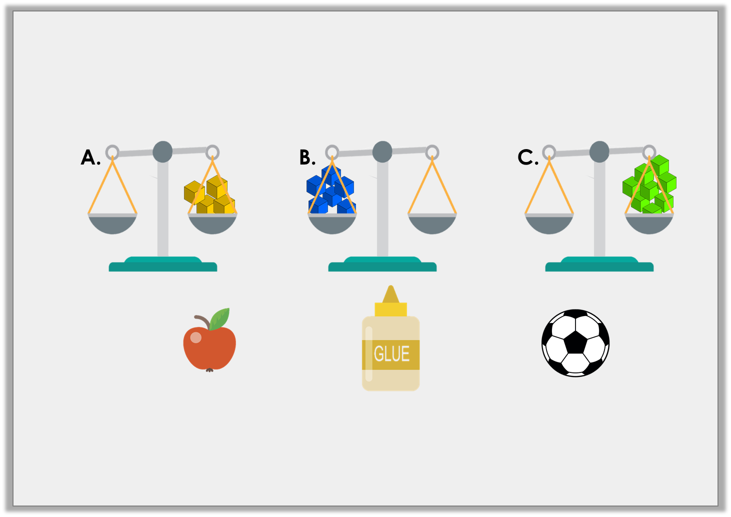
Introduction
Match the object to the correct scale.
4 cubes
8 cubes
6 cubes
Y1
© Classroom Secrets Limited 2019

Slide 4
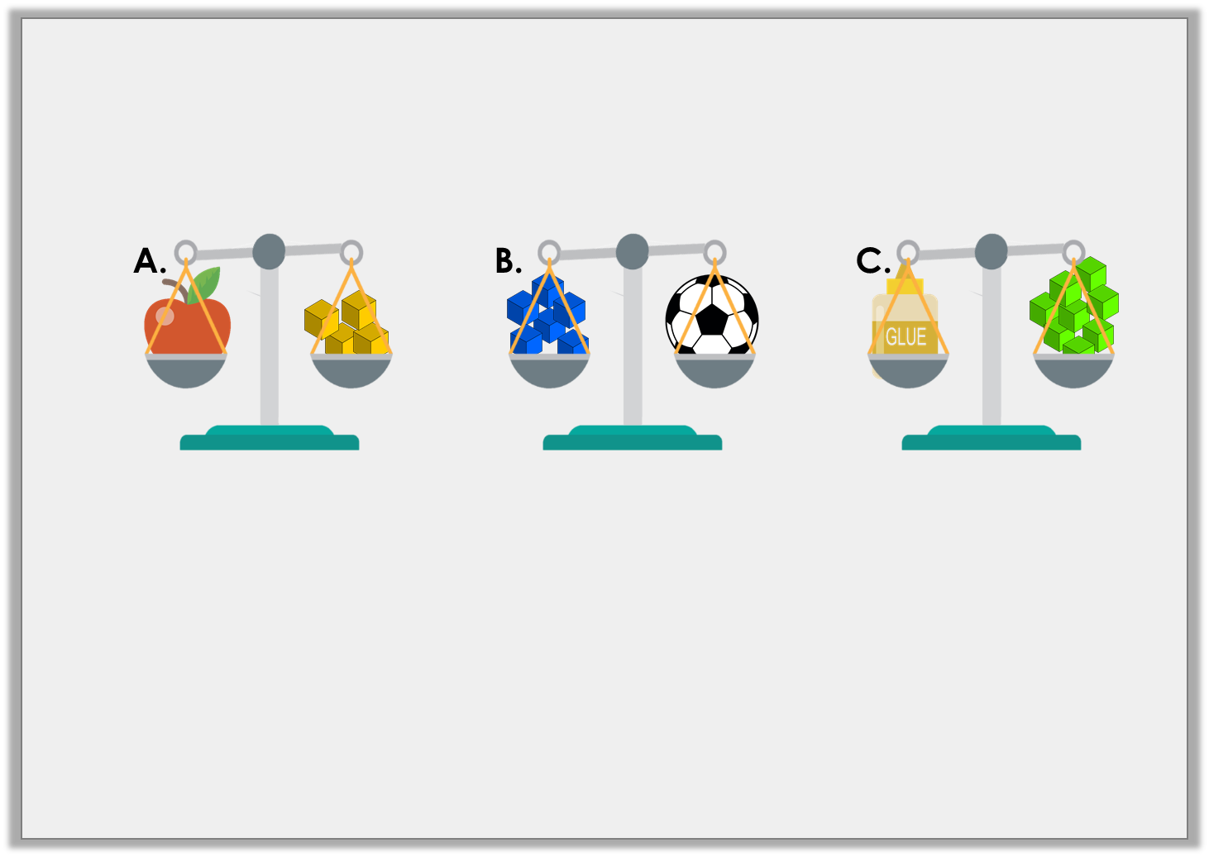
Introduction
Match the object to the correct scale.
4 cubes
6 cubes
8 cubes
Y1
© Classroom Secrets Limited 2019

Slide 5
Introduction
Identify which kilogram each arrow is pointing to on the scales.
20kg
30kg
10kg
20kg
30kg
10kg
35kg
60kg
Y2
© Classroom Secrets Limited 2018

Slide 6
Introduction
Identify which kilogram each arrow is pointing to on the scales.
20kg
25kg
30kg
10kg
20kg
26kg
30kg
10kg
20kg
35kg
60kg
Y2
© Classroom Secrets Limited 2018

Slide 7
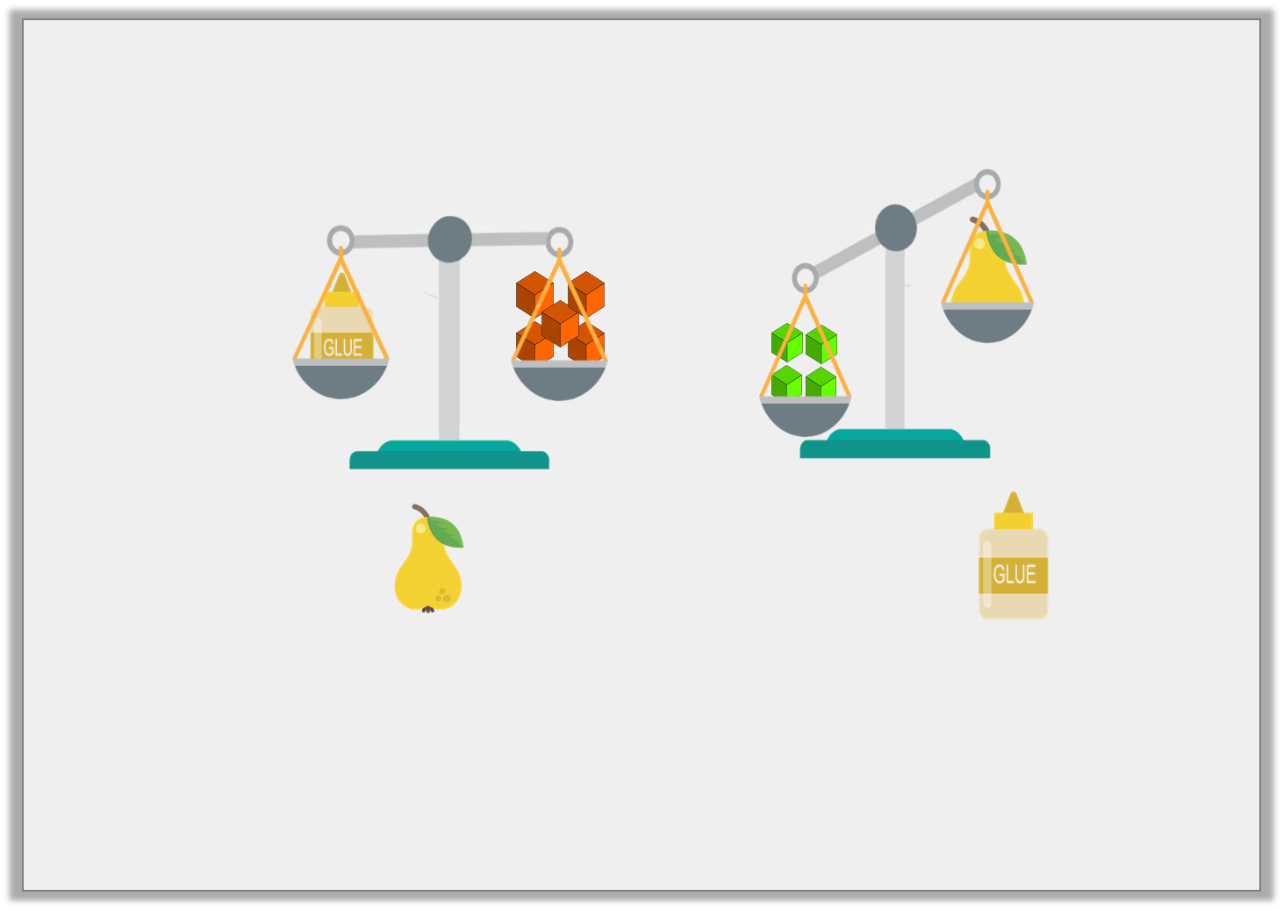
Varied Fluency 1
Choose the word to complete the sentence below.
The is than the .
heavier
lighter
Y1
© Classroom Secrets Limited 2019

Slide 8
Varied Fluency 1
Choose the word to complete the sentence below.
The is than the .
lighter
heavier
lighter
Y1
© Classroom Secrets Limited 2019

Slide 9
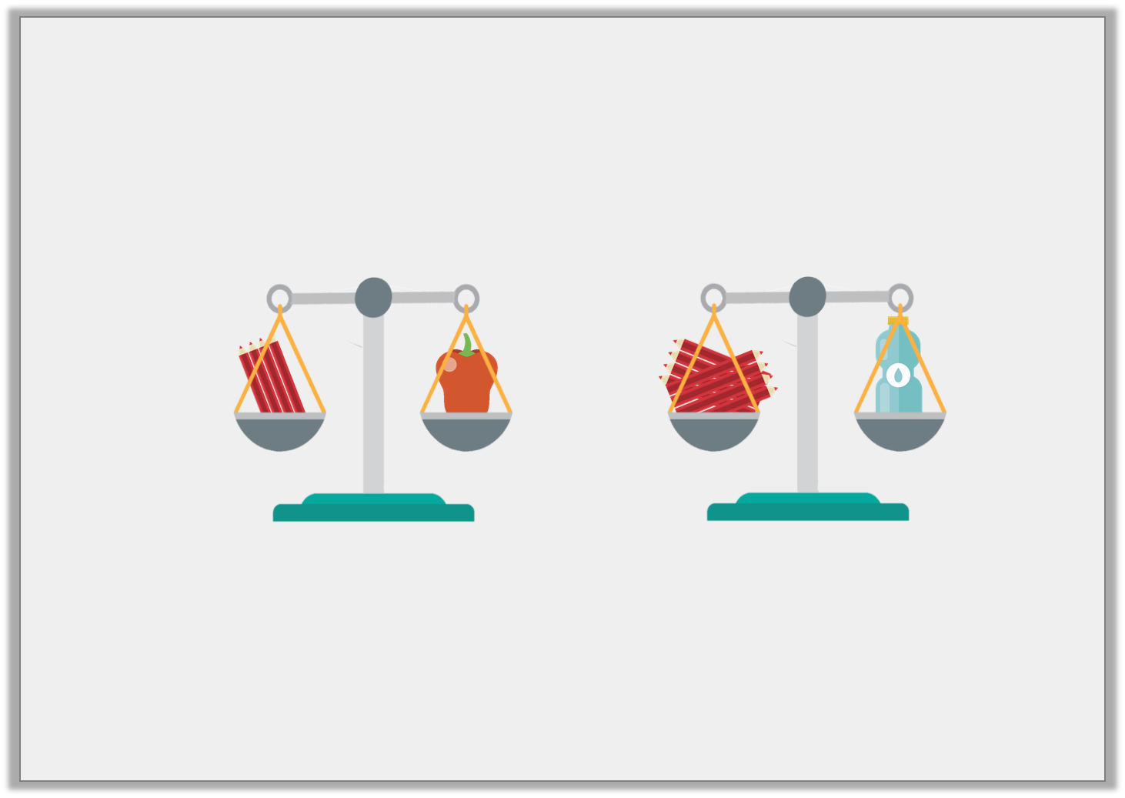
Varied Fluency 2
True or false? The bottle is heavier than the pepper.
Y1
© Classroom Secrets Limited 2019

Slide 10
Varied Fluency 2
True or false? The bottle is heavier than the pepper.
True, the bottle weighs 8 pencils and the pepper weighs 4 pencils.
Y1
© Classroom Secrets Limited 2019

Slide 11
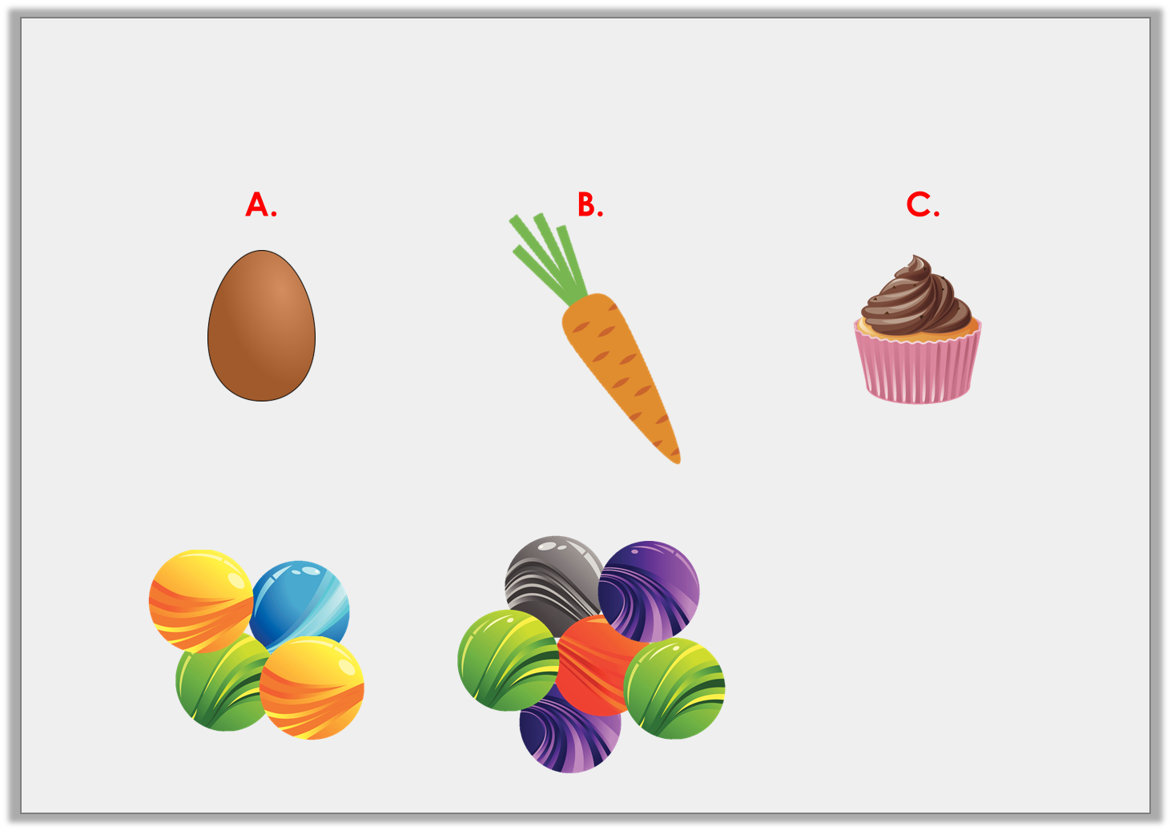
Varied Fluency 3
Order the objects, heaviest to lightest.
an egg
weighs
a carrot
weighs
a bun
weighs
2 marbles lighter than an egg
Y1
© Classroom Secrets Limited 2019

Slide 12
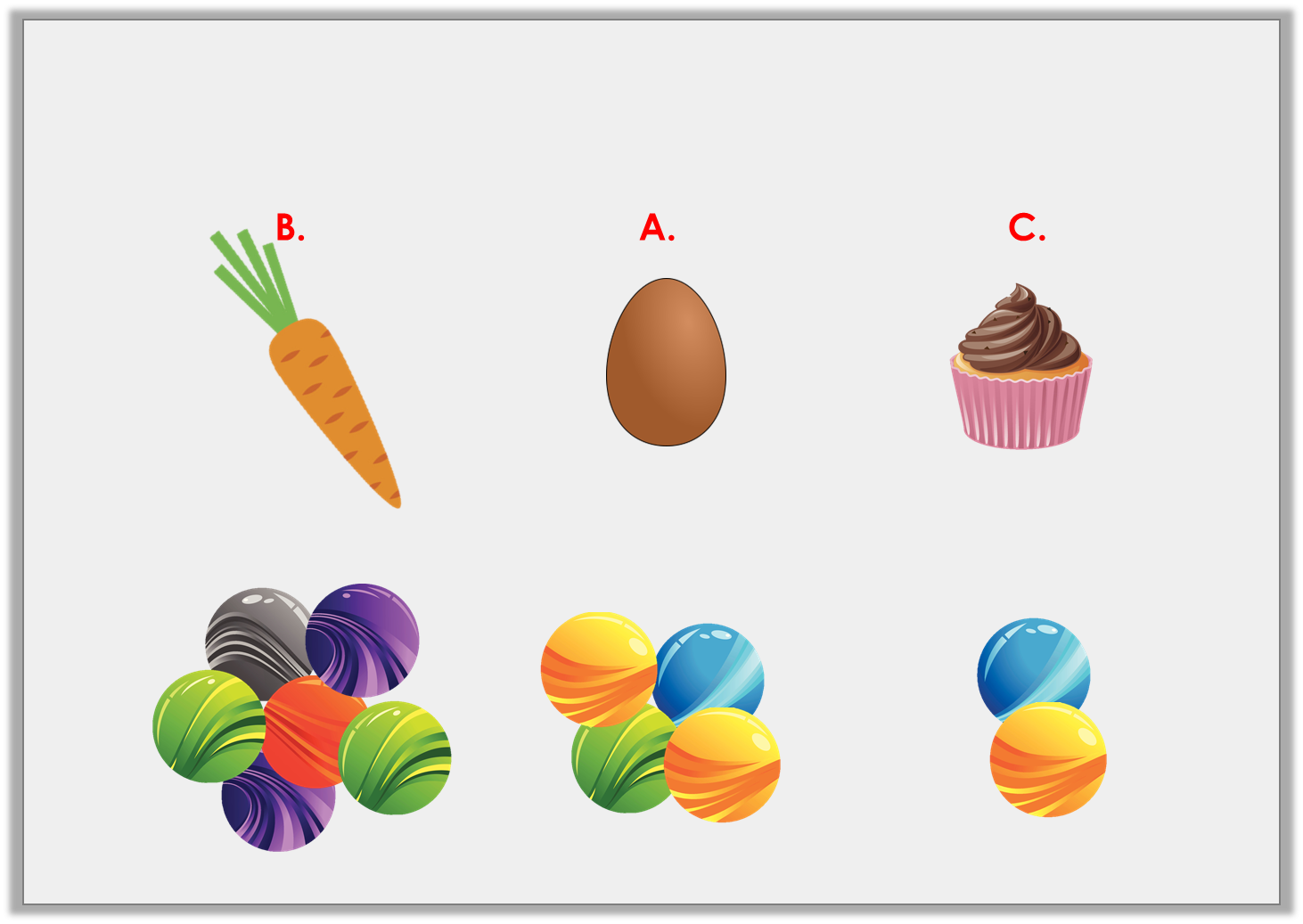
Varied Fluency 3
Order the objects, heaviest to lightest.
a carrot
weighs
an egg
weighs
a bun
weighs
Y1
© Classroom Secrets Limited 2019

Slide 13
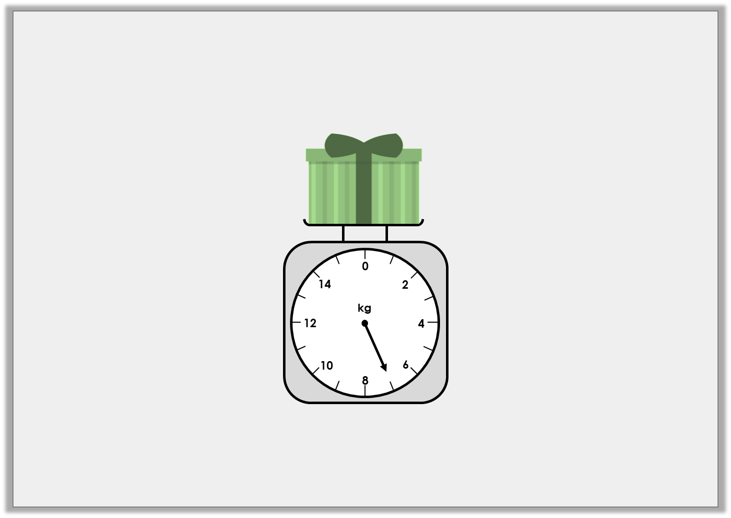
Varied Fluency 1
What weight does the scale show?
Y2
© Classroom Secrets Limited 2018

Slide 14
Varied Fluency 1
What weight does the scale show?
7kg
Y2
© Classroom Secrets Limited 2018

Slide 15
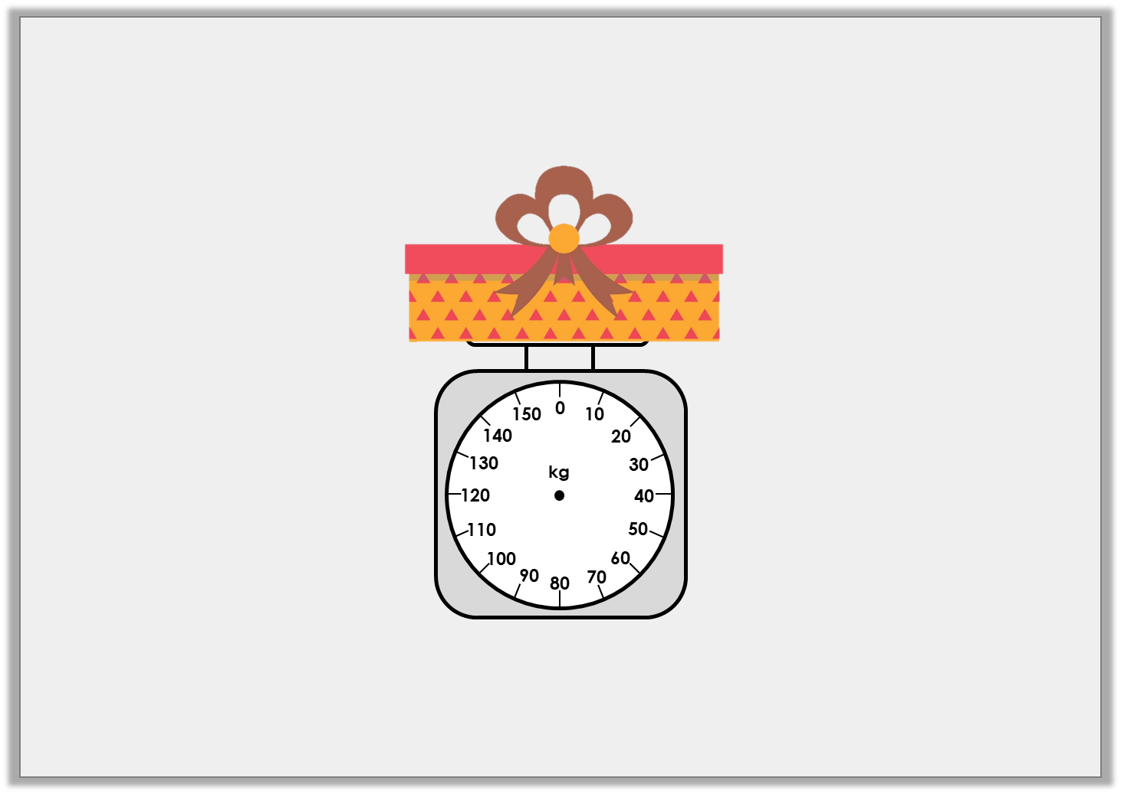
Varied Fluency 2
Add an arrow to the scale so that it shows 60kg.
Y2
© Classroom Secrets Limited 2018

Slide 16
Varied Fluency 2
Add an arrow to the scale so that it shows 60kg.
Y2
© Classroom Secrets Limited 2018

Slide 17
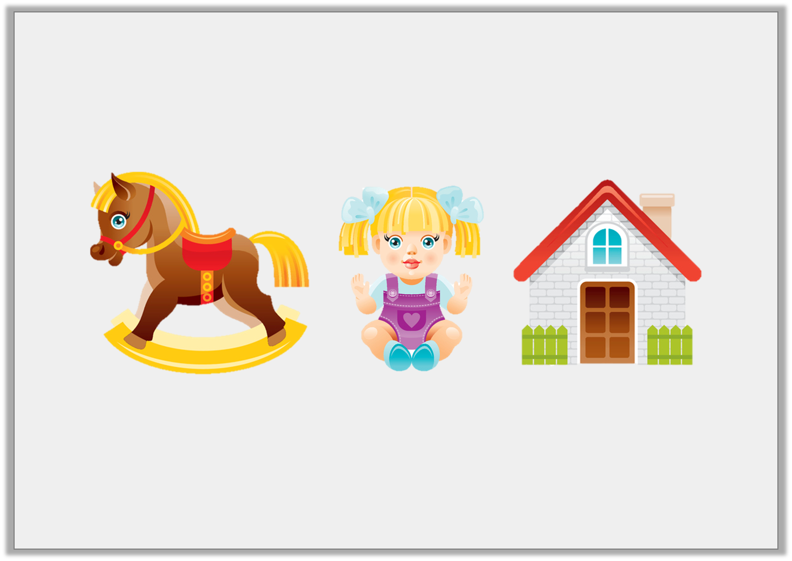
Varied Fluency 3
Order these toys from lightest to heaviest.
20kg
12kg
15kg
Y2
© Classroom Secrets Limited 2018

Slide 18
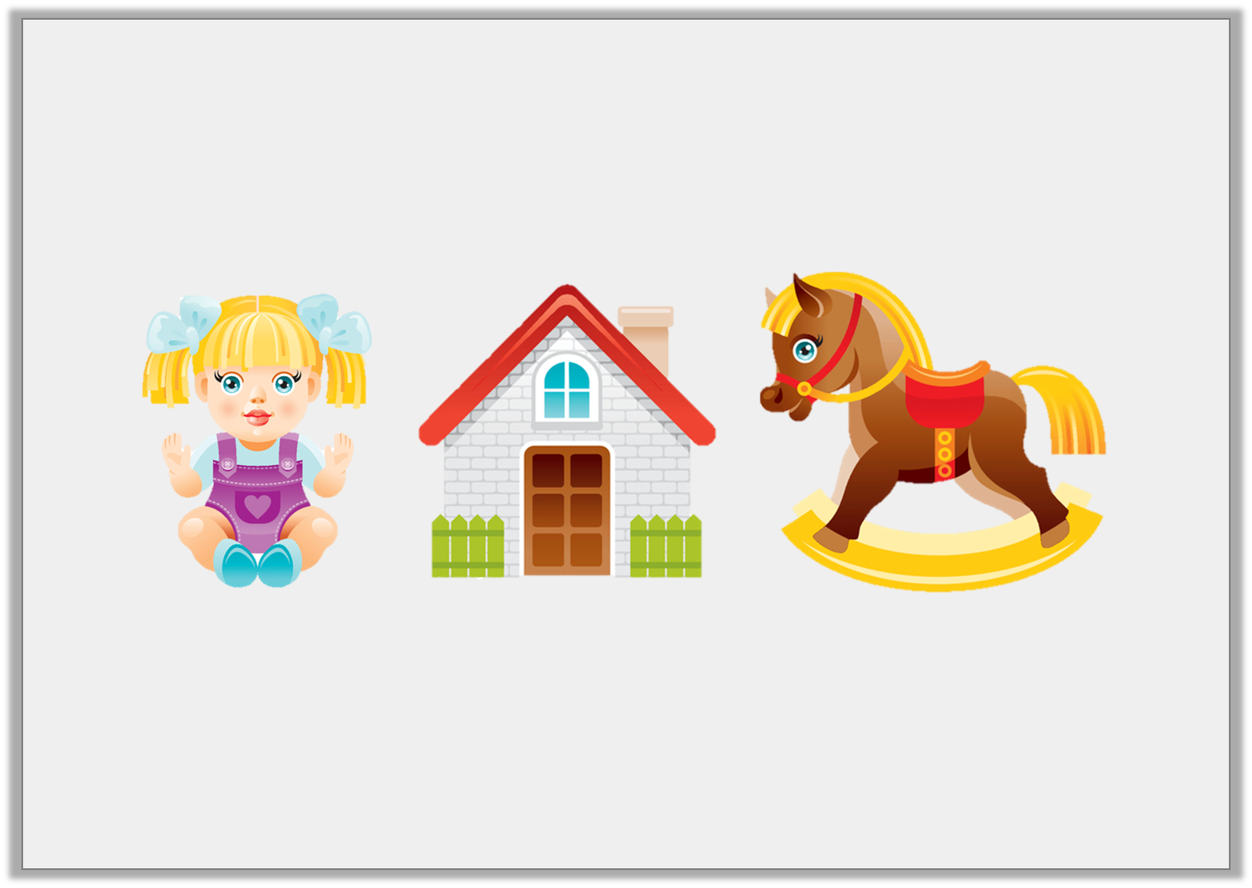
Varied Fluency 3
Order these toys from lightest to heaviest.
12kg
15kg
20kg
Y2
© Classroom Secrets Limited 2018

Slide 19
Varied Fluency 4
Circle the most reasonable estimate for the mass of this person.
10kg |  | 1kg |  | 100kg
Y2
© Classroom Secrets Limited 2018

Slide 20
Varied Fluency 4
Circle the most reasonable estimate for the mass of this person.
10kg |  | 1kg |  | 100kg
Y2
© Classroom Secrets Limited 2018

Slide 21
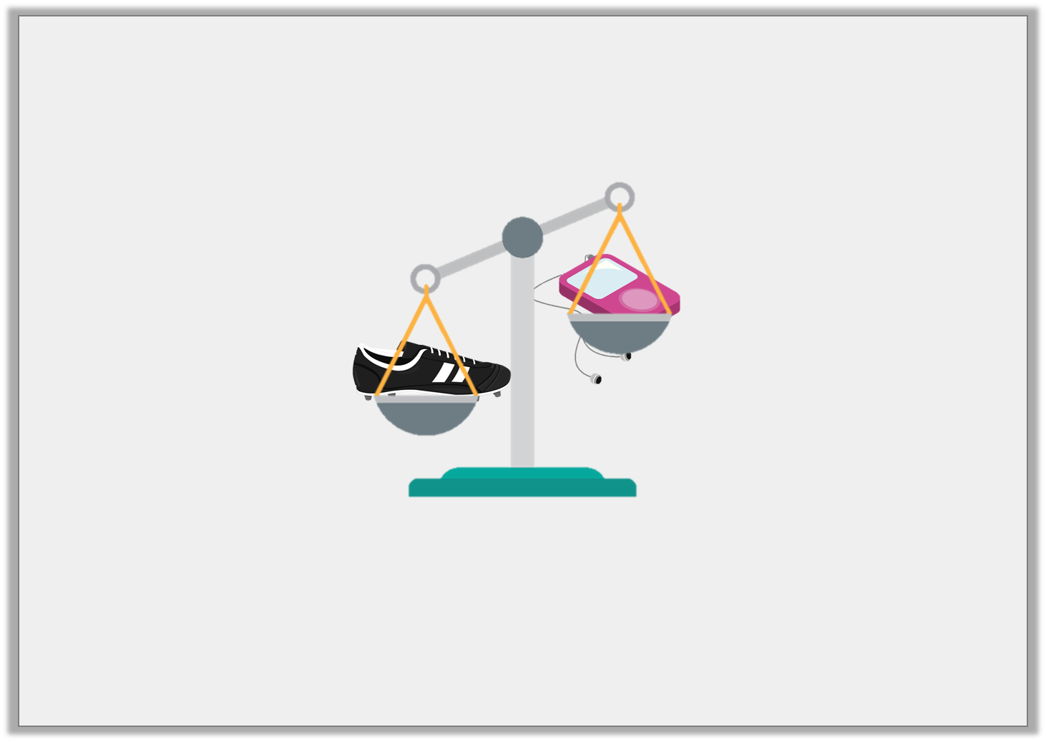
Problem Solving 1
A football boot weighs 20 pencils.
A music player weighs 7 pencils.
How many pencils are needed to make the scales balance?
5
13
3
Y1
© Classroom Secrets Limited 2019

Slide 22
Problem Solving 1
A football boot weighs 20 pencils.
A music player weighs 7 pencils.
How many pencils are needed to make the scales balance?
5
13
3
Y1
© Classroom Secrets Limited 2019

Slide 23
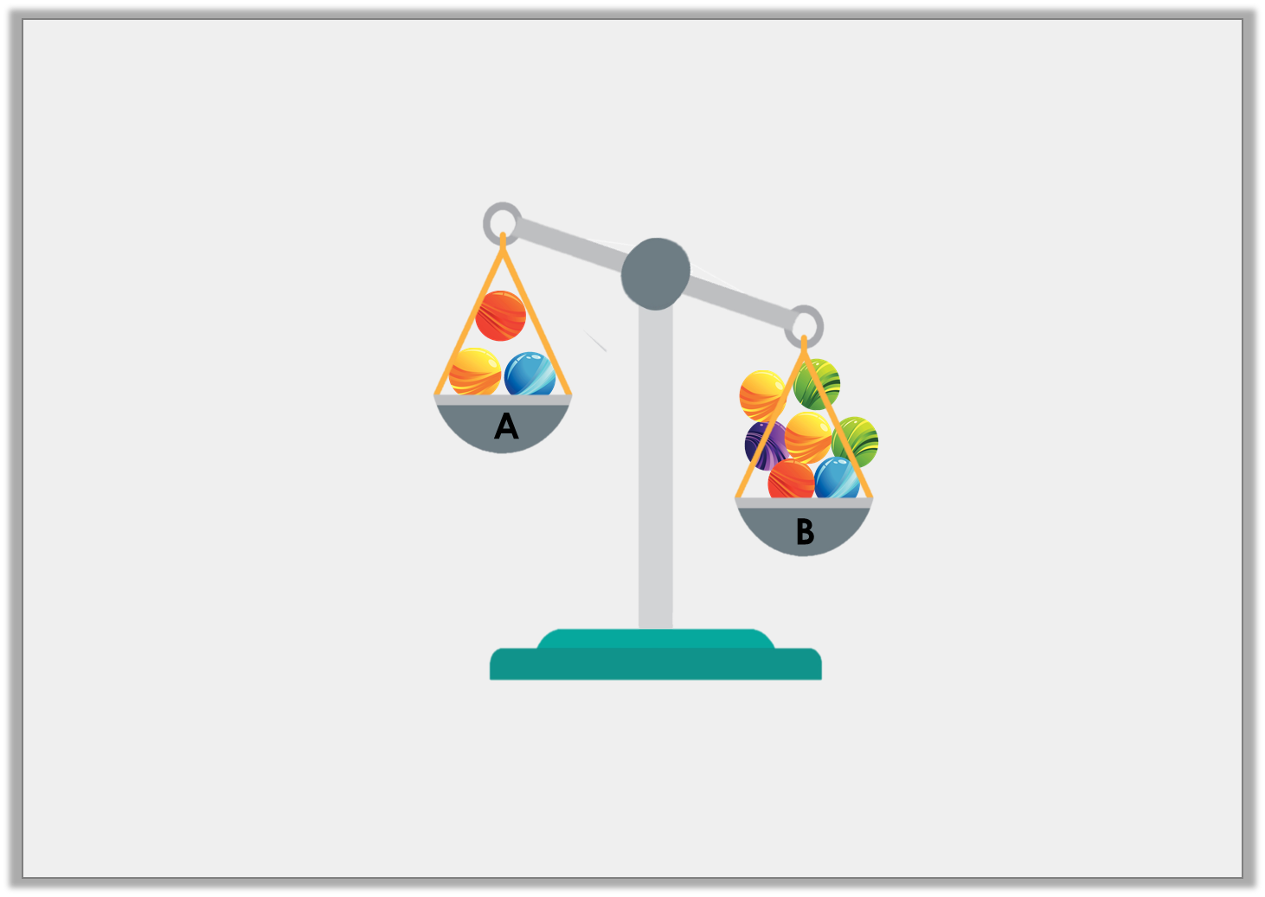
Reasoning 1
George wants the scales to balance. He thinks he could move some marbles to do this.
Is he correct? Explain your answer.
Y1
© Classroom Secrets Limited 2019

Slide 24
Reasoning 1
George wants the scales to balance. He thinks he could move some marbles to do this.
Is he correct? Explain your answer.
He is correct because…
Y1
© Classroom Secrets Limited 2019

Slide 25
Reasoning 1
George wants the scales to balance. He thinks he could move some marbles to do this.
Is he correct? Explain your answer.
He is correct because he could move 2 marbles from tray B to tray A, so that they would then have 5 marbles on each side.
Y1
© Classroom Secrets Limited 2019

Slide 26
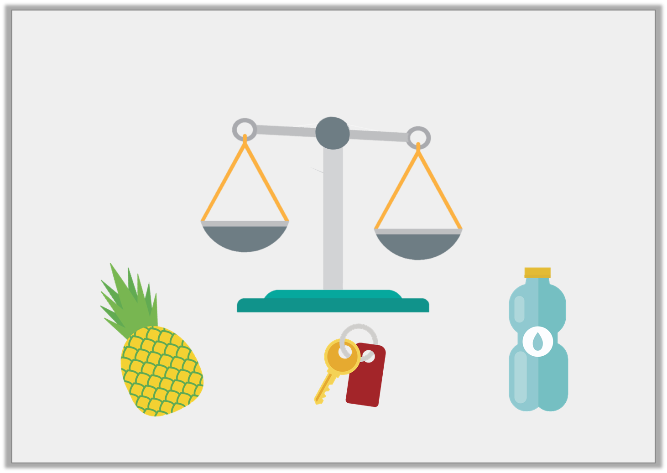
Problem Solving 2
Draw an arrow to show how you could position the objects on the scales to make them balance.
7 blocks
3 blocks
10 blocks
Y1
© Classroom Secrets Limited 2019

Slide 27
Problem Solving 2
Draw an arrow to show how you could position the objects on the scales to make them balance.
+
=
7 blocks
7 blocks
3 blocks
3 blocks
10 blocks
10 blocks
Y1
© Classroom Secrets Limited 2019

Slide 28
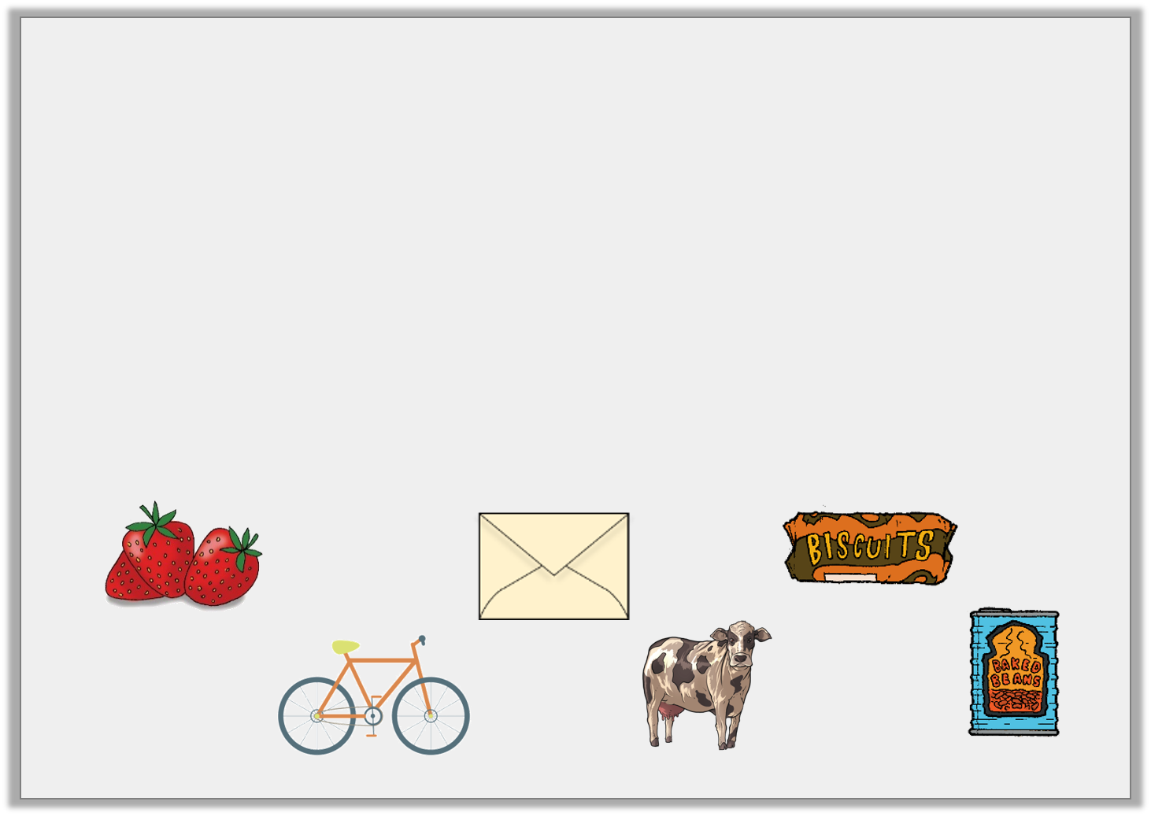
Problem Solving 1
Sort the objects into the table.
Things you would weigh in kilograms | Things you would weigh in grams
Y2
© Classroom Secrets Limited 2018

Slide 29
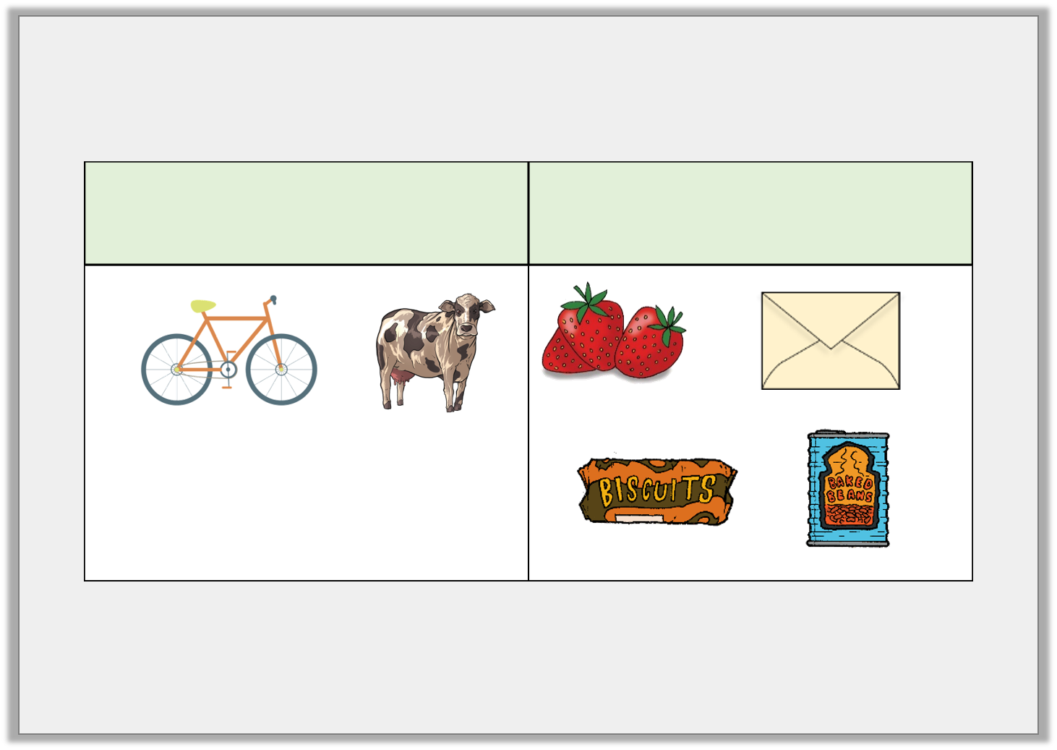
Problem Solving 1
Sort the objects into the table.
Things you would weigh in kilograms | Things you would weigh in grams
Y2
© Classroom Secrets Limited 2018

Slide 30
Problem Solving 2
Use < or > to complete this statement.
Dog |  | Cow |  | Chair
30kg |  | 290kg |  | 8kg
Y2
© Classroom Secrets Limited 2018

Slide 31
Problem Solving 2
Use < or > to complete this statement.
Dog |  | Cow |  | Chair
30kg |  | 290kg |  | 8kg
<
>
Y2
© Classroom Secrets Limited 2018

Slide 32
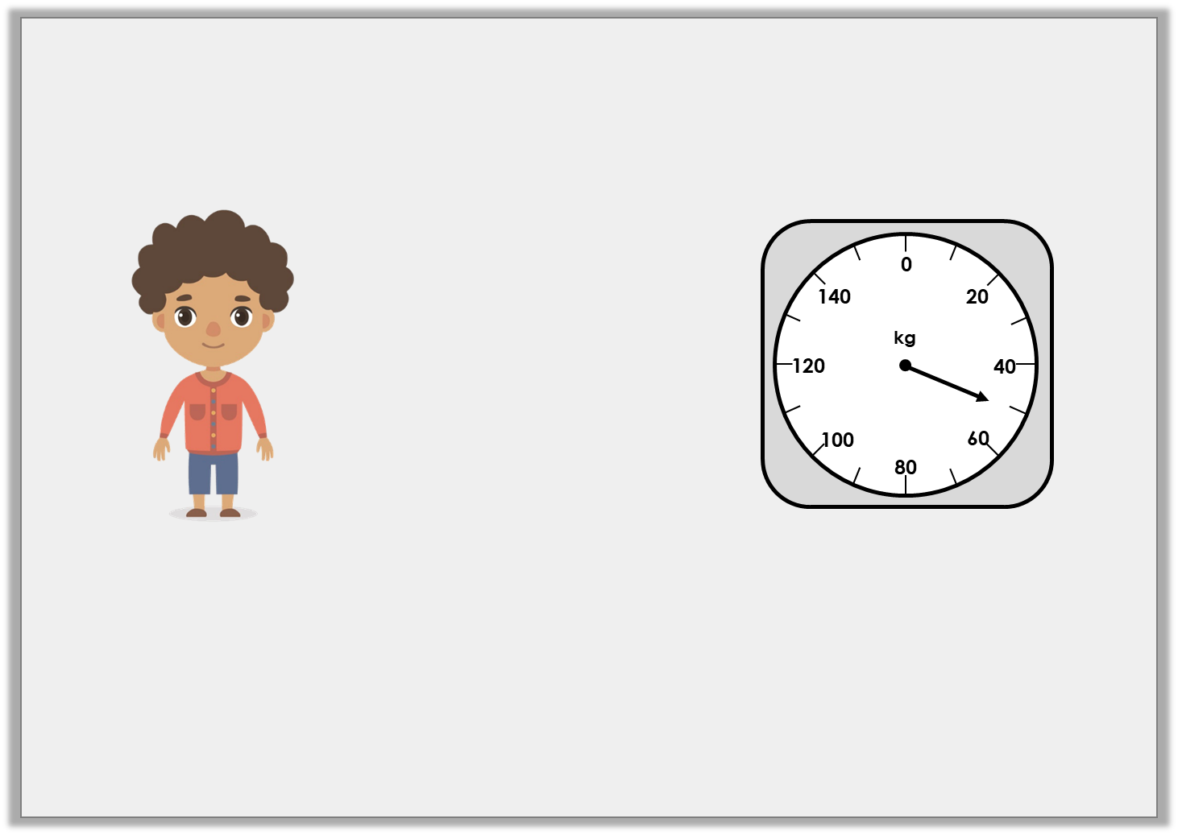
Reasoning 1
The scale shows how much a Year 2 child weighs.
Is Nick correct? How can you tell?
I weigh 41kg.
Y2
© Classroom Secrets Limited 2018

Slide 33
Reasoning 1
The scale shows how much a Year 2 child weighs.
Is Nick correct? How can you tell?
Nick is incorrect because…
I weigh 41kg.
Y2
© Classroom Secrets Limited 2018

Slide 34
Reasoning 1
The scale shows how much a Year 2 child weighs.
Is Nick correct? How can you tell?
Nick is incorrect because the scale shows 50kg.
I weigh 41kg.
Y2
© Classroom Secrets Limited 2018

