Slide 1
Year 1/2 – Spring Block 4 – Weight and Volume – Step 4
About This Resource:
This PowerPoint has been designed to support your teaching of this small step from the Mixed Age planning. It includes a starter activity suitable for each year group and an example of each question from the Varied Fluency and Reasoning and Problem Solving resources also provided in this pack (separate for each year group). Each slide has the year group identified in the bottom right-hand corner. We recommend that you look through this PowerPoint in advance and decide whether to work through all examples provided or a selection of them depending on the needs of your class.
National Curriculum Objectives:
Mathematics Year 1: (1M1) Compare, describe and solve practical problems for: capacity and volume [for example, full/empty, more than, less than, half, half full, quarter]
Mathematics Year 1: (1M2) Measure and begin to record: capacity and volume
Mathematics Year 2: (2M1) Compare and order lengths, mass, volume/capacity and record the results using >, < and =
More Year 1 and 2 Weight and Volume resources.
Did you like this resource? Don’t forget to review it on our website.
© Classroom Secrets Limited 2019

Slide 2
Year 1/2 – Spring Block 4 – Weight and Volume
Step 4
Year 1: Introduce Capacity
Year 2: Compare Capacity
© Classroom Secrets Limited 2019

Slide 3
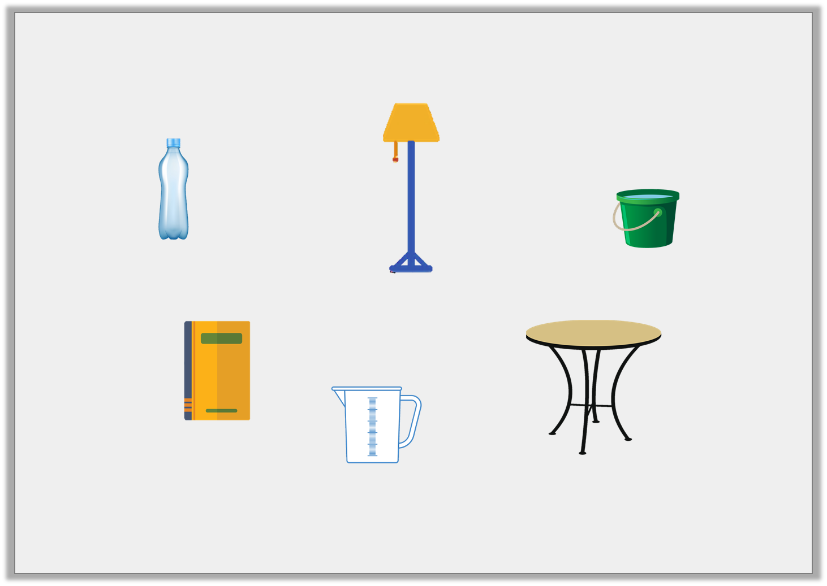
Introduction
Circle the objects that can be filled with water.
Y1
© Classroom Secrets Limited 2019

Slide 4
Introduction
Circle the objects that can be filled with water.
You can fill the bottle, jug and bucket with water.
Y1
© Classroom Secrets Limited 2019

Slide 5
Introduction
Put the containers in order from smallest to biggest capacity.
Y2

Slide 6
Introduction
Put the containers in order from smallest to biggest capacity.
smallest capacity
biggest capacity
Y2

Slide 7
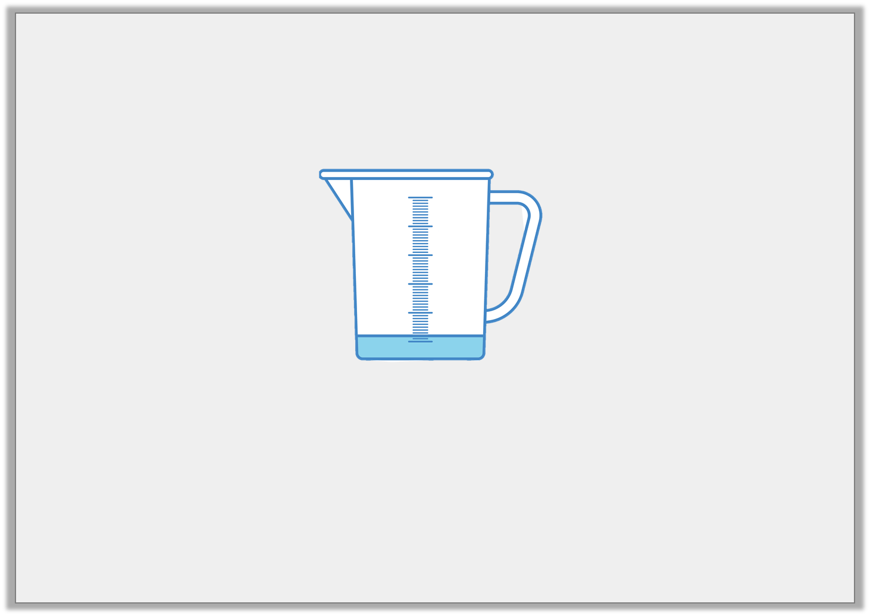
Varied Fluency 1
Tick the box which best describes the volume of the jug below.
nearly empty
nearly full
half full
Y1
© Classroom Secrets Limited 2019

Slide 8
Varied Fluency 1
Tick the box which best describes the volume of the jug below.
nearly empty
nearly full
half full
Y1
© Classroom Secrets Limited 2019

Slide 9
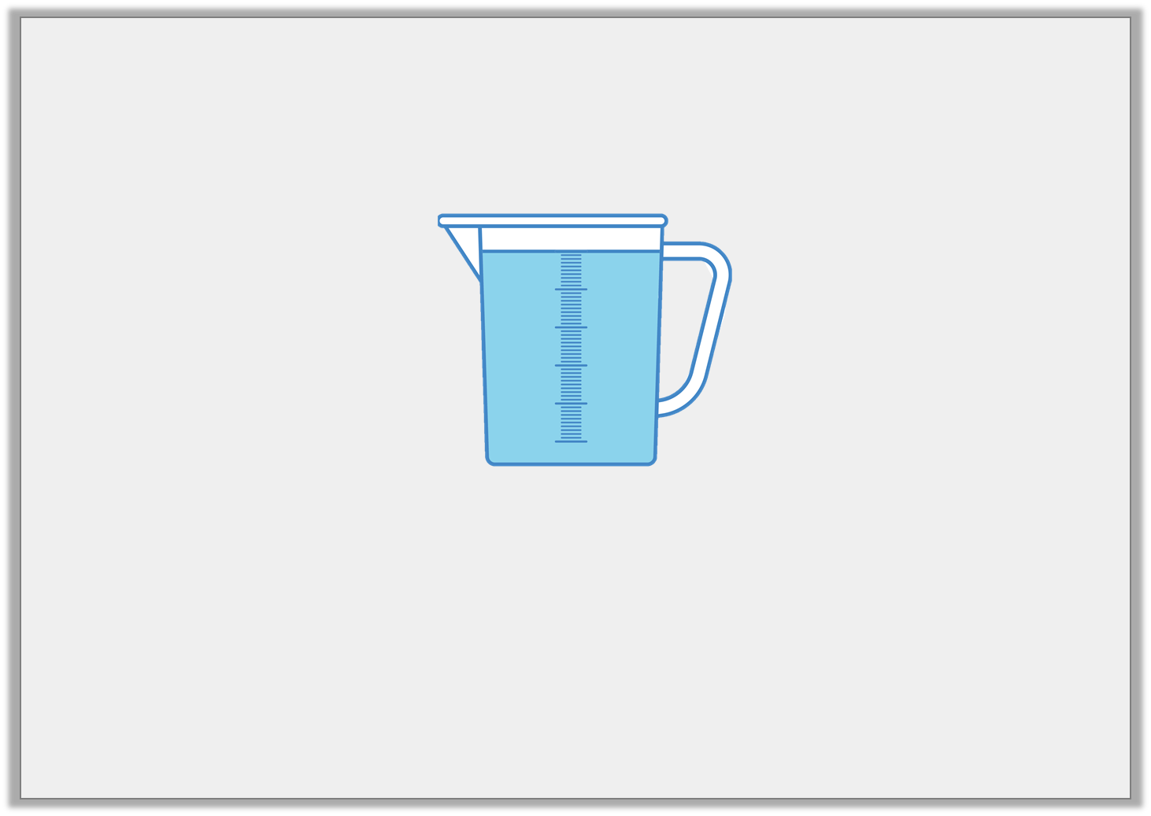
Varied Fluency 2
True or false? The jug below is nearly empty.
Y1
© Classroom Secrets Limited 2019

Slide 10
Varied Fluency 2
True or false? The jug below is nearly empty.
False, the jug is nearly full.
Y1
© Classroom Secrets Limited 2019

Slide 11
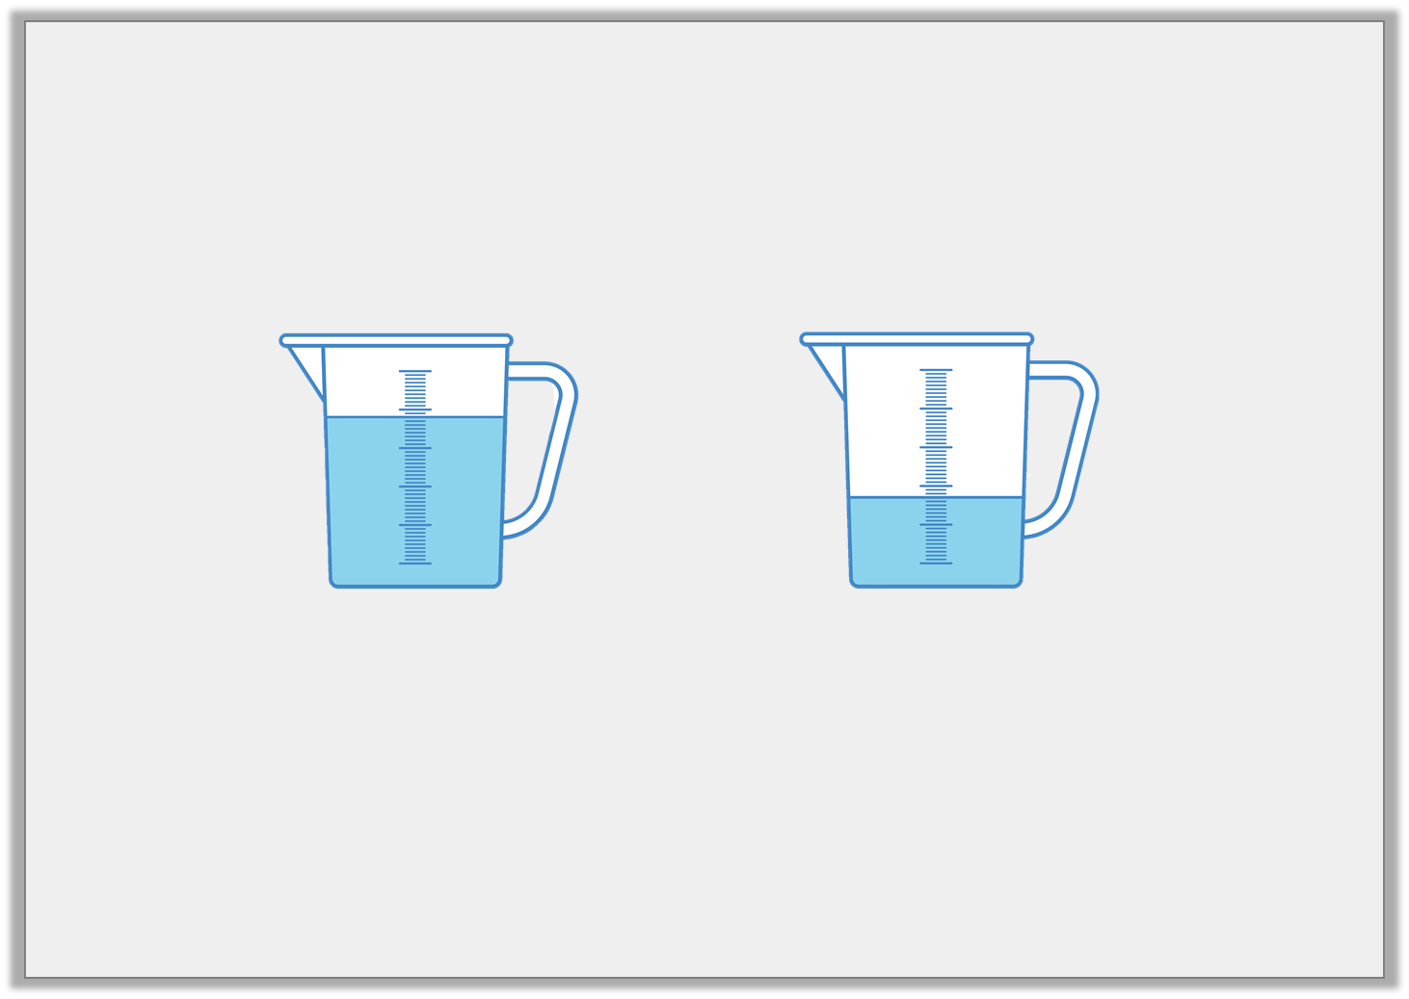
Varied Fluency 3
Which sentence is correct?
1. The capacity of jug A is equal to jug B.
2. The volume of jug A is less than jug B.
A
B
Y1
© Classroom Secrets Limited 2019

Slide 12
Varied Fluency 3
Which sentence is correct?
1. The capacity of jug A is equal to jug B.
2. The volume of jug A is less than jug B.
A
B
Y1
© Classroom Secrets Limited 2019

Slide 13
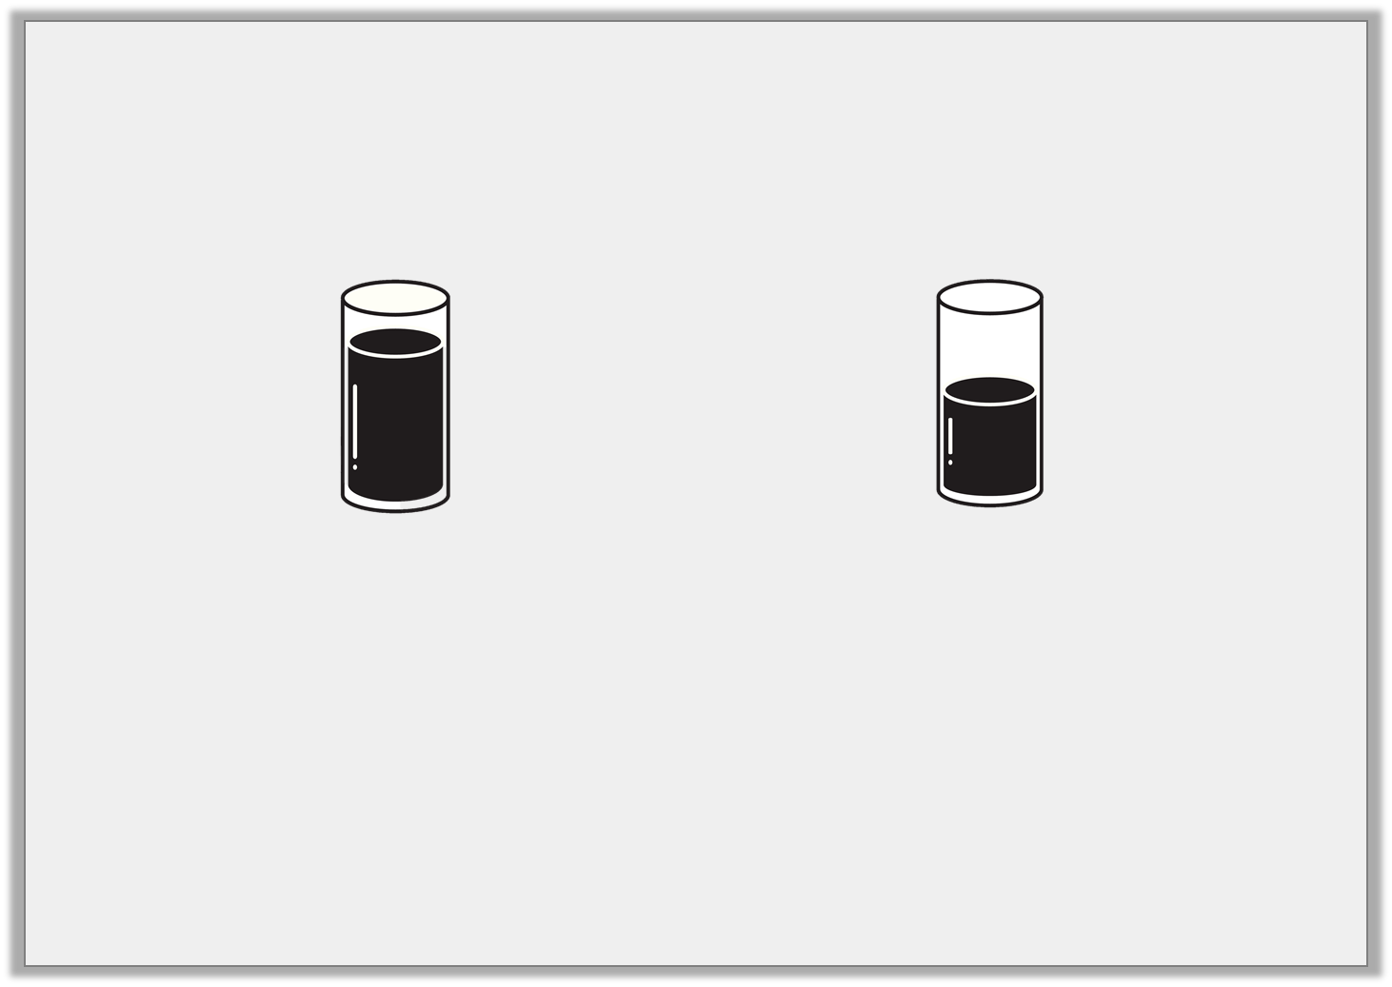
Varied Fluency 4
Complete the sentence.
is ________
greater than
less than
Y1
© Classroom Secrets Limited 2019

Slide 14
Varied Fluency 4
Complete the sentence.
is ________
greater than
greater than
less than
Y1
© Classroom Secrets Limited 2019

Slide 15
Varied Fluency 1
The volume of the container below is a quarter full.
True or false?
Y2

Slide 16
Varied Fluency 1
The volume of the container below is a quarter full.
True or false?
True
Y2

Slide 17
Varied Fluency 2
Use <, > and = symbols to compare the capacity
of container A with container B.
Y2

Slide 18
Varied Fluency 2
Use <, > and = symbols to compare the capacity
of container A with container B.
<
>
=
Y2

Slide 19
Varied Fluency 3
Draw a line to the word that best describes
the volume of each container.
full | quarter | half | three-quarters
Y2

Slide 20
Varied Fluency 3
Draw a line to the word that best describes
the volume of each container.
full | quarter | half | three-quarters
Y2

Slide 21
Varied Fluency 4
Order these items from the
largest capacity to the smallest capacity.
Y2

Slide 22
Varied Fluency 4
Order these items from the
largest capacity to the smallest capacity.
largest capacity
smallest capacity
Y2

Slide 23
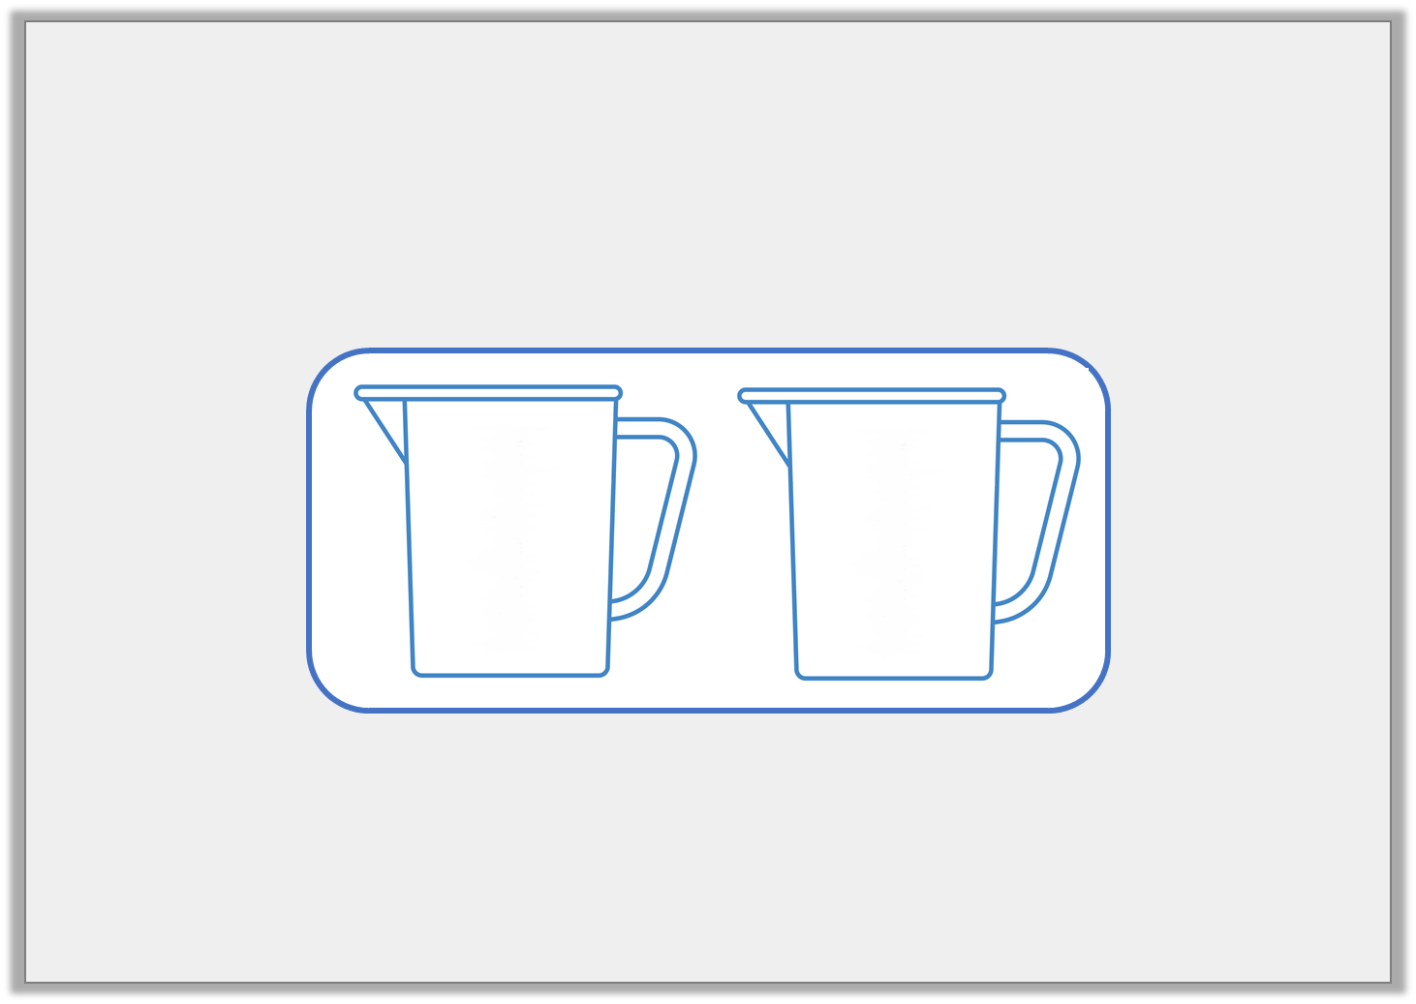
Problem Solving 1
Colour each jug to match the label.
half full
nearly empty
Y1
© Classroom Secrets Limited 2019

Slide 24
Problem Solving 1
Colour each jug to match the label.
Children should colour half of the first jug and a small amount of the second jug.
half full
nearly empty
Y1
© Classroom Secrets Limited 2019

Slide 25
Reasoning 1
Sam says,
Is he correct? Explain your answer.
The glass is nearly full.
Y1
© Classroom Secrets Limited 2019

Slide 26
Reasoning 1
Sam says,
Is he correct? Explain your answer.
No Sam is not correct. The glass is…
The glass is nearly full.
Y1
© Classroom Secrets Limited 2019

Slide 27
Reasoning 1
Sam says,
Is he correct? Explain your answer.
No Sam is not correct. The glass is half full.
The glass is nearly full.
Y1
© Classroom Secrets Limited 2019

Slide 28
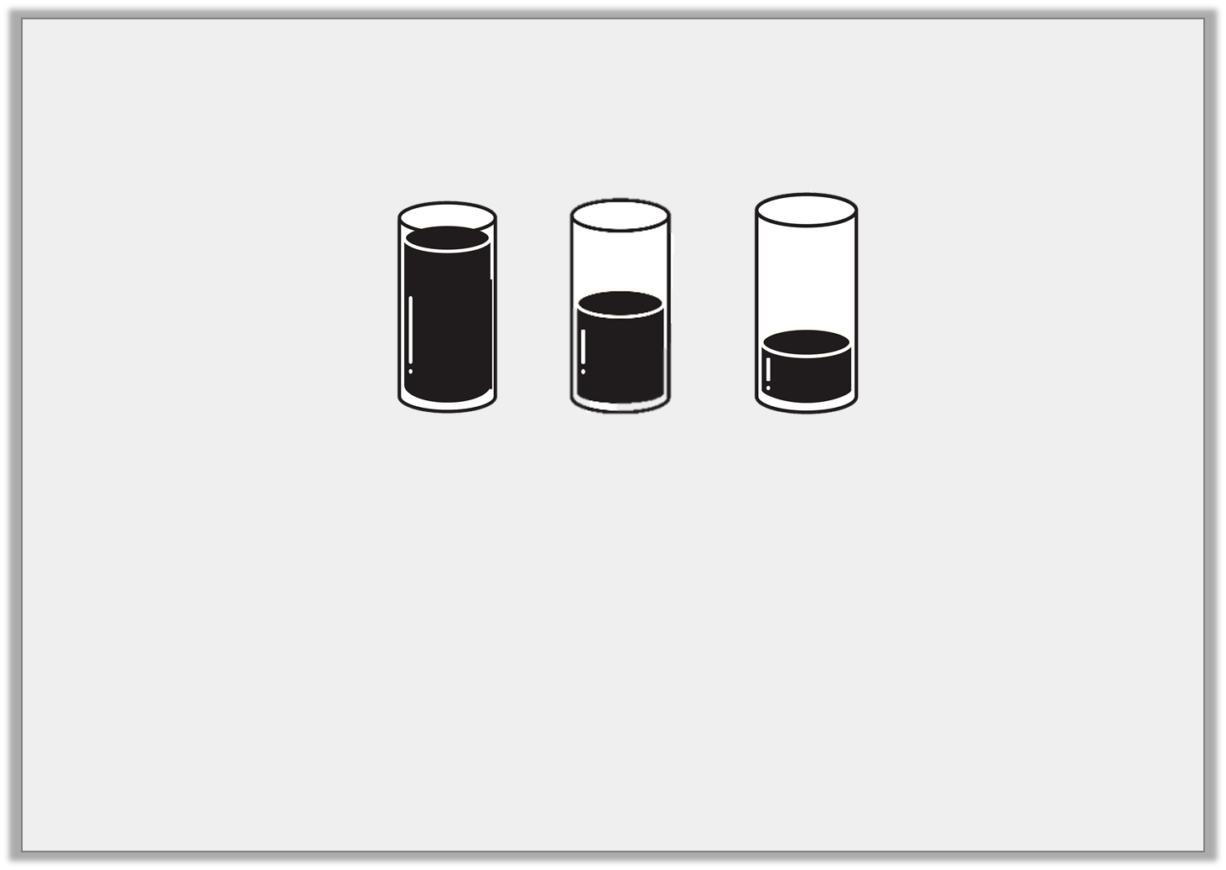
Problem Solving 2
Tick the boxes to show if the sentence is true or false.
Sentence |  | True | False
A. | Nearly empty is greater than half full.
B. | Nearly empty is greater than empty.
Y1
© Classroom Secrets Limited 2019

Slide 29
Problem Solving 2
Tick the boxes to show if the sentence is true or false.
Sentence |  | True | False
A. | Nearly empty is greater than half full. |  | 
B. | Nearly empty is greater than empty. | 
Y1
© Classroom Secrets Limited 2019

Slide 30
Reasoning 1
Which container has the largest capacity?
How do you know?
Y2

Slide 31
Reasoning 1
Which container has the largest capacity?
How do you know?
Container A because...
Y2

Slide 32
Reasoning 1
Which container has the largest capacity?
How do you know?
Container A because it can hold 4 full glasses and 1 part glass which is more than 2 full glasses and 3 part glasses.
Y2

Slide 33
Problem Solving 1
Complete these statements using <, > and = symbols.
Y2

Slide 34
Problem Solving 1
Complete these statements using <, > and = symbols.
<
=
Y2

Slide 35
Reasoning 2
Daisy knows that 8 jugs of water will fill 5 buckets or 10 bowls.
Is she right? Explain your answer.
I think that the capacity of a bowl is greater than the capacity of a jug.
Y2

Slide 36
Reasoning 2
Daisy knows that 8 jugs of water will fill 5 buckets or 10 bowls.
Is she right? Explain your answer.
Daisy is incorrect because...
I think that the capacity of a bowl is greater than the capacity of a jug.
Y2

Slide 37
Reasoning 2
Daisy knows that 8 jugs of water will fill 5 buckets or 10 bowls.
Is she right? Explain your answer.
Daisy is incorrect because with the same amount of water you can fill more bowls than buckets so the bowls must have a smaller capacity.
I think that the capacity of a bowl is greater than the capacity of a jug.
Y2

