Slide 1
Art Curriculum Self Portraits of Class 4 in the Style of Paul Klee
WB-13.7.20

Slide 2
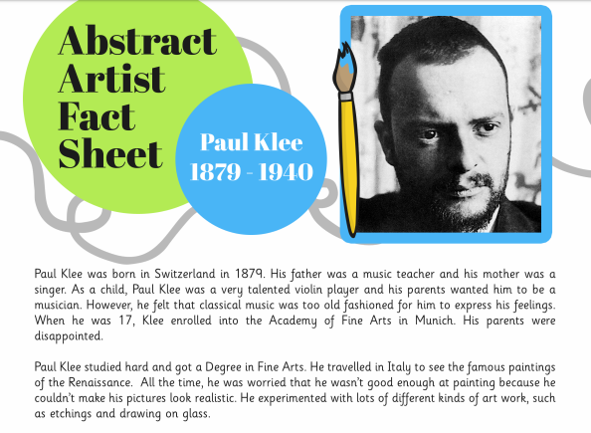
Wednesday 15th July: Find out here about about Paul Klee.

Slide 4
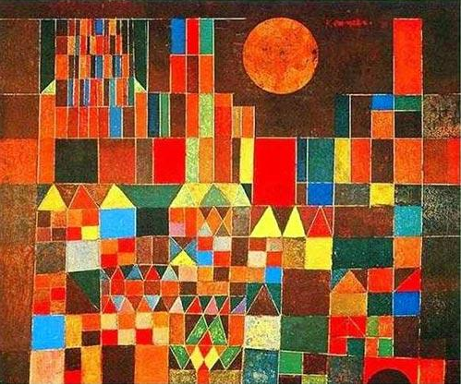
Look at the following picture by Paul Klee. Look at his use of lines and colour. Can you recreate a similar picture? How does the title to this piece of art link to it?
Castle and sun 1928

Slide 5
Wednesday 15th July
Look at the 4 following pictures by the artist Paul Klee. Create a mindmap of ideas
What does he draw?
How does he use colour?
What medium (paint etc) could he be using?
What types of lines does he use?

Slide 6
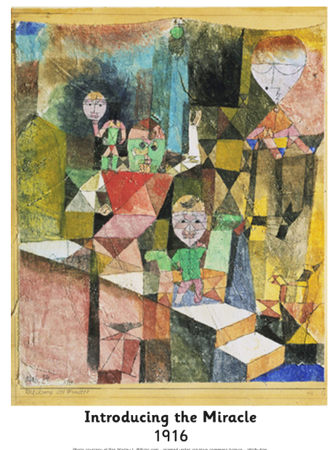
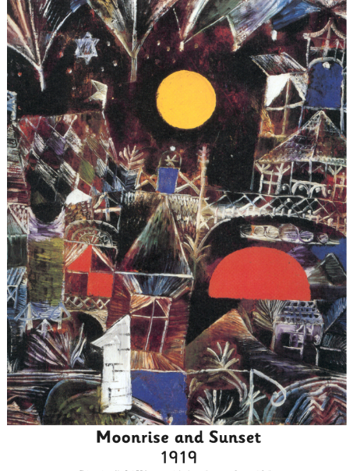

Slide 7
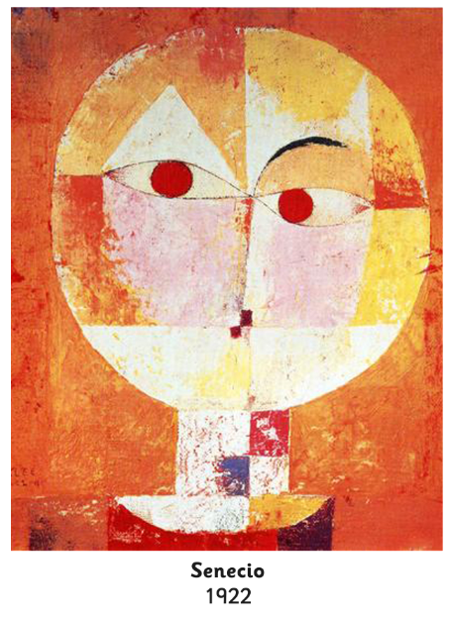
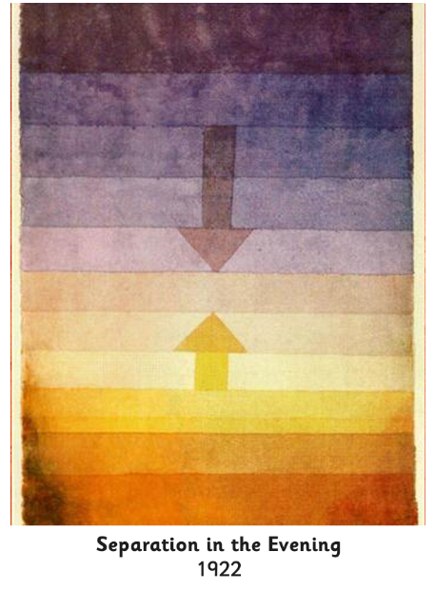

Slide 8
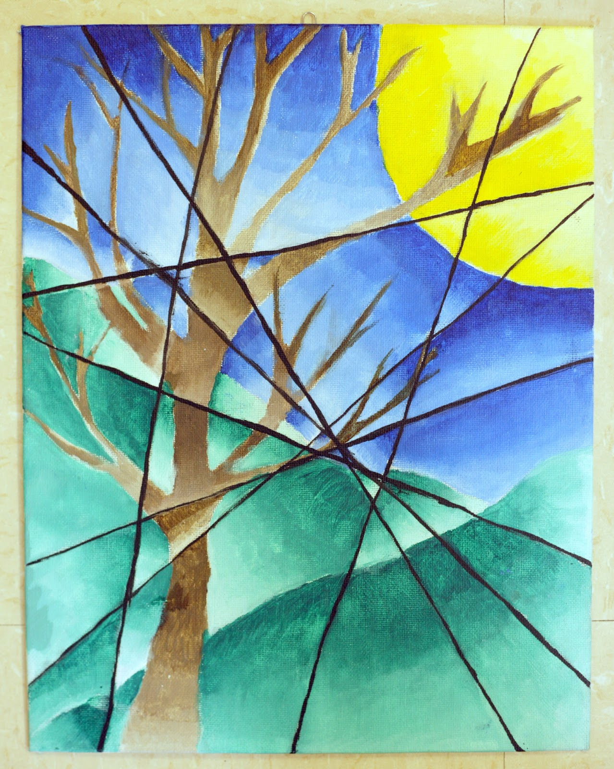
Wednesday 15th July
Can you create your own image inspired by Paul Klee?
Ideas on next slide
Step 1: Decide on your image
Step 2: Draw image
Step 3: Using a ruler add straight lines across the image
Step 4: Add different colours, tones and shades to each section

Slide 9
